Slide 1
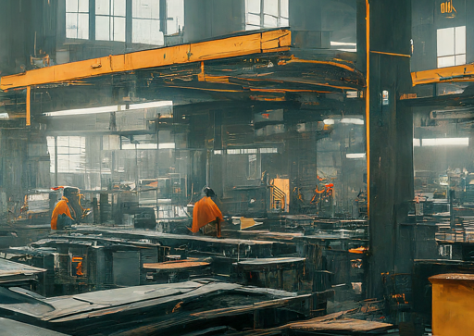
MCN401: INDUSTRIAL SAFETY ENGINEERING

Slide 2
SYLLABUS
Need for safety. Safety and productivity.
Definitions: Accident, Injury, Unsafe act, Unsafe Condition, Dangerous Occurrence, Reportable accidents.
Theories of accident causation. Safety organization- objectives, types, functions, Role of management, supervisors, workmen, unions, government and voluntary agencies in safety. Safety policy. Safety Officer-responsibilities, authority. Safety committee-need, types, advantages.

Slide 3
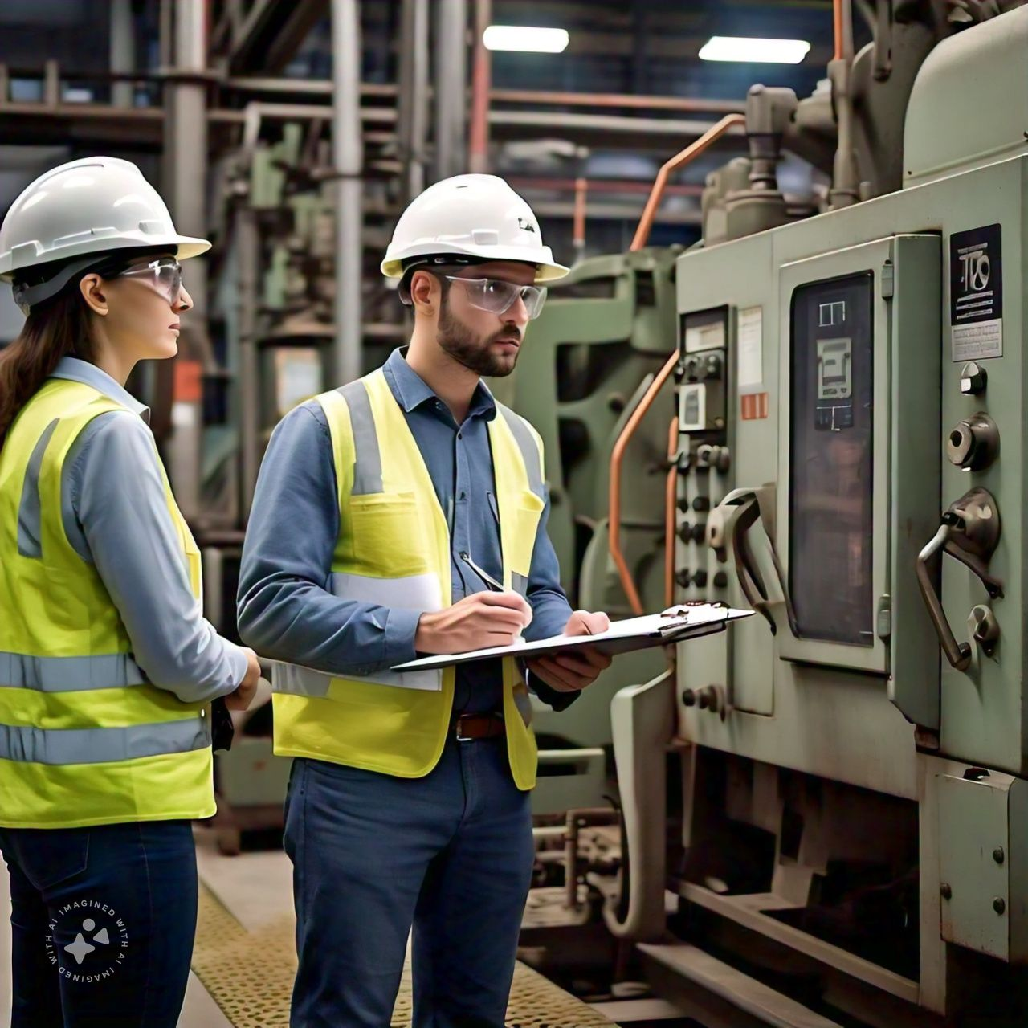
INTRODUCTION
Industrial safety refers to the safety management practices that apply to the industrial sector.
Those processes aim to protect industrial workers, machinery, facilities, structures, and the environment.
Industrial safety is overseen by federal, state and local laws and regulations.
The Occupational Safety and Health Association (OSHA) is the primary regulatory body in the United States dedicated to workplace safety, including the industrial sector.

Slide 4
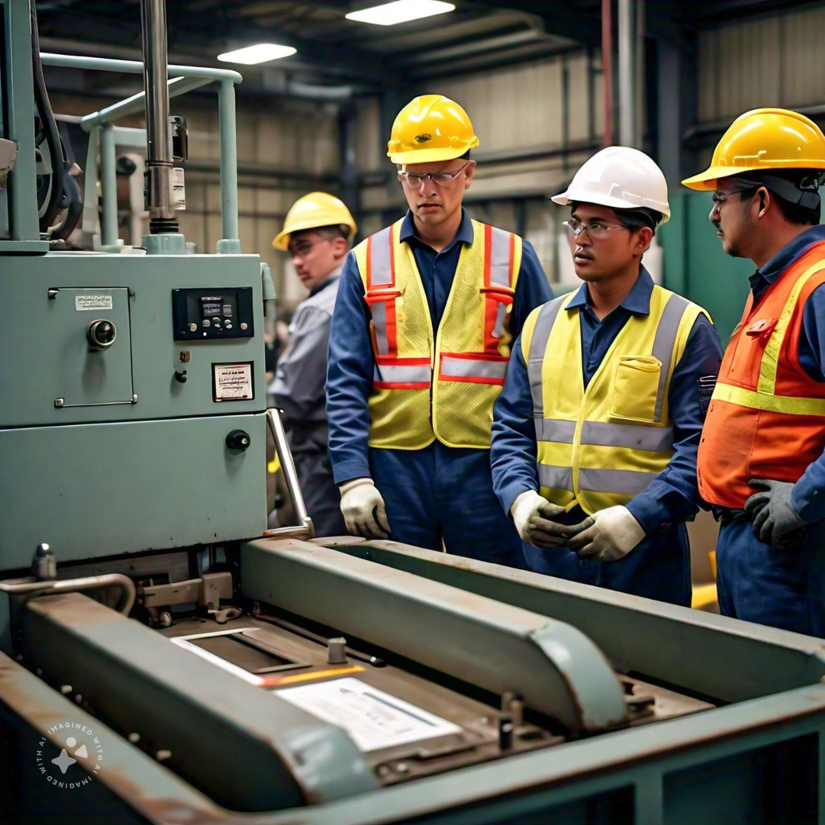
Industrial safety is a broad area of workplace safety, covering a number of issues and topics, including:
General safety (issues and concerns that are common across all industries)
Site-specific safety issues
Process and production safety
Material safety
Fire safety
Electrical safety
Building and structural safety (including temporary installations)
Environmental safety

Slide 5
What is industrial safety?
Primarily a management activity which is concerned with
Reducing
Controlling
Eliminating hazards from the industries or industrial units.

Slide 6
OBJECTIVES OF INDUSTRIAL SAFETY ENGIEERING
To prevent accidents in the plant by reducing the hazard to minimum.
To eliminate accident caused work stoppage and lost production.
To achieve lower workmen’s compensation, insurance rates and reduce all other direct and indirect costs of accidents.
To prevent loss of life, permanent disability and the loss of income of worker by eliminating causes of accidents.
To evaluate employee’s morale by promoting safe work place and good working condition
To educate all members of the organization in continuous state of safety mindless and to make supervision competent and intensely safety minded

Slide 7

SAFETY MANAGEMENT
Safety management in industry, also known as industrial safety, is a multi-disciplinary approach to protecting employees, assets, and the environment from hazards, risks, accidents, and near misses.
It involves managing all operations and procedures within an industry to ensure compliance with regulations, safe working practices, and the health and well-being of employees.
It defines industrial safety as management activities that reduce, control, and eliminate hazards from industries.
The objectives of industrial safety are to prevent accidents, injuries, production losses, and increase morale and production

Slide 8
NEED FOR SAFETY
To protect health of all employees
- To ensure well being of all workers
- To promote positive culture in all organization or company
- To ensure accident and incident prevention
- To ensure organization development and its growth
- To ensure continual improvement of company

Slide 9
Workers who sustain lost time injuries can be difficult to replace.
Because of this, injuries can have significant effects on a company's production output, shipping schedules, fulfillment and customer satisfaction.
Good safety practices, then, not only keep workers safe but also help maintain employee, vendor, and client satisfaction.

Slide 10
NEED FOR SAFETY
1. Social Need
The accident causes social loss in great magnitude in form of suffering, loss of earning capacity and cost due to disturbance to economic efficiency.
2. Management Need
Management bear huge loss due to accident.
Cost of accident is two Types Direct & Indirect cost.
Indirect cost is several times more than Direct Cost.
Direct cost include medical expenses, compensation to the injured or their families.
3. Legal Need
As per The Building & other construction Act 1996, Factories Act 1948 and several other related Acts & rules the general duty of the employer is to ensure Health & Safety of his employee & protect the Environment.
4. Humanitarian Need
The Humanitarian reason for prevention of accidents is based on notion that it is duty of every person to ensure safety of his fellow men

Slide 11
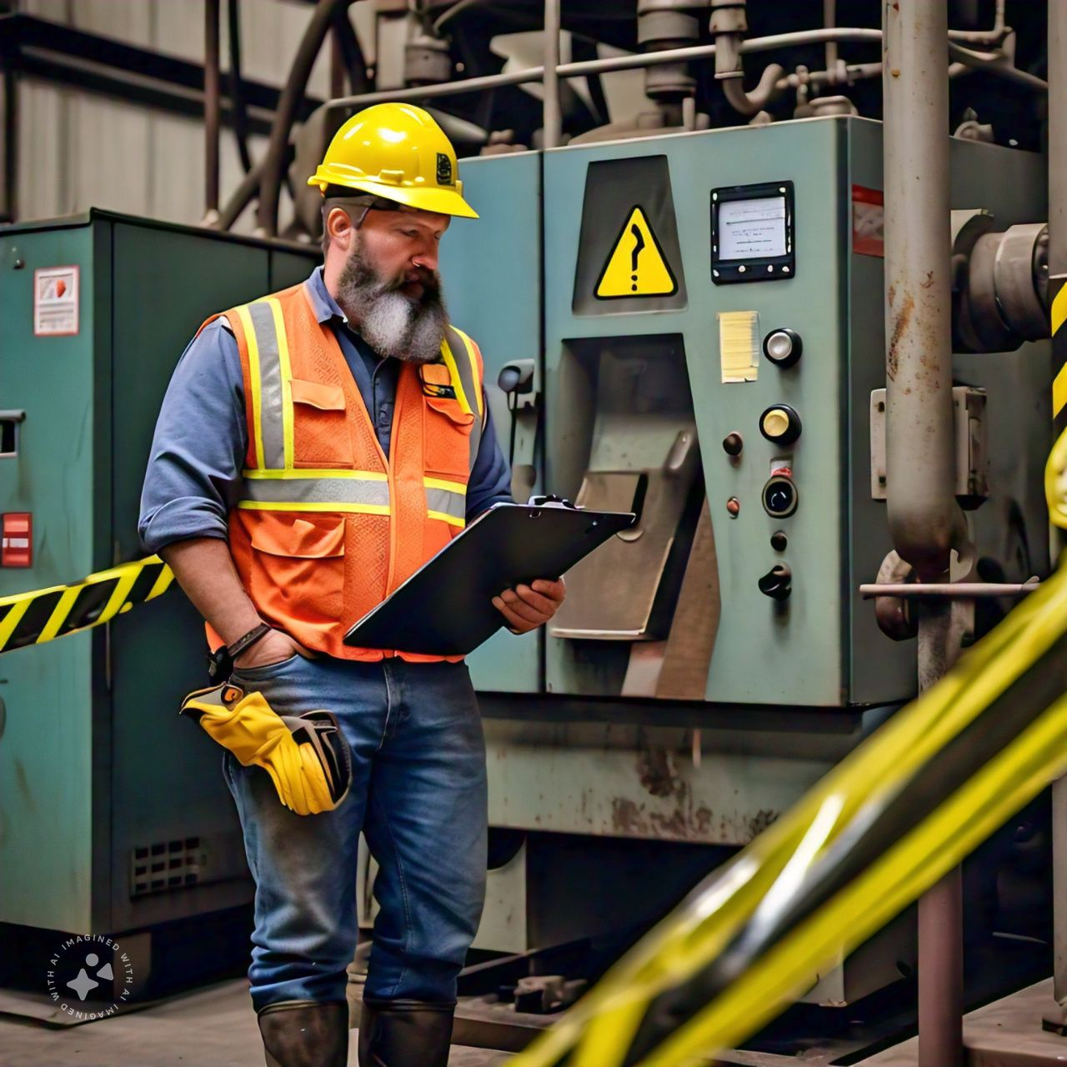
FOUR E’s OF SAFETY
Engineering: Safe design and equipment
Education: Educating employees
Enforcement: Enlisting positive attitudes from employees and management
Encouragement: Providing encouragement to follow safe rules and practices

Slide 12
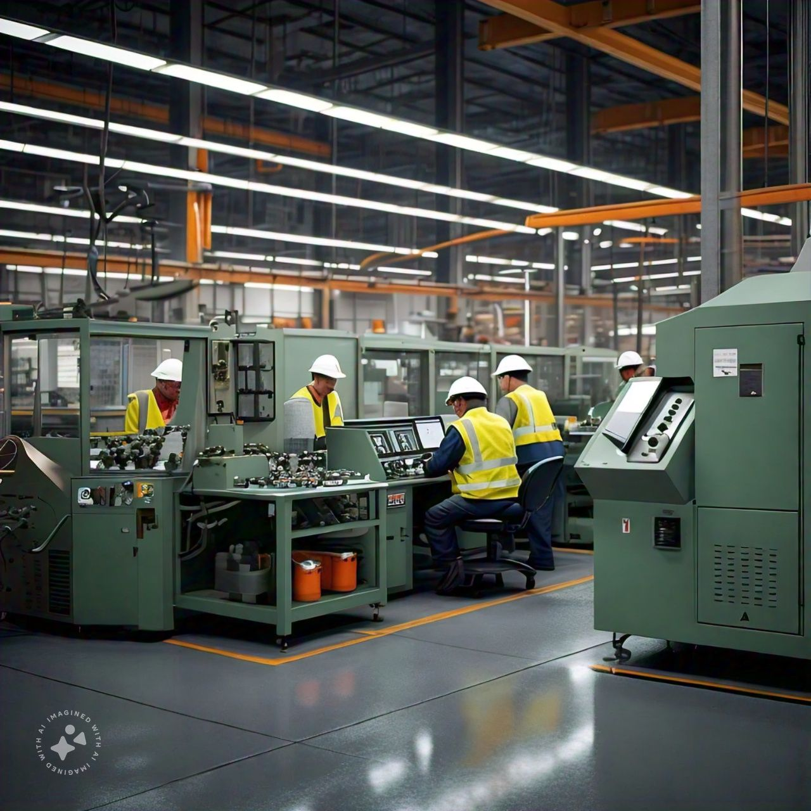
SAFETY & PRODUCTIVITY
Safety, quality, and productivity are inextricably linked
When organizations put better care into maintaining their safety, quality, and productivity, they are also better able to serve their customers and protect their employees

Slide 13
SAFETY AND PRODUCTIVITY
The safety of people, machines, and processes is a key element of any sustainable business or organization.
• Top manufacturers continue to discredit the age-old notion that safety and productivity have separate and competitive goals.
• These leaders use a combination of integrated safety solutions and new international standards to optimize their uptime and productivity.
• Workplace productivity is dependent on employee safety. As such, employers should put safety first before focusing on productivity.
• Increasing safety in the workplace can significantly boost productivity.
• An unsafe work environment lowers productivity
• Workplace productivity refers to the amount of work accomplished by employees over a given period.
• Having a workforce that is engaged and committed can help maximize productivity.
• Productivity levels can be measured by comparing input and work output.
• The quantity and quality of work delivered by each employee can either increase or reduce productivity in the workplace.

Slide 14
Productive workplace offers a wide range of benefits to the company, employer, and employees:
Increased Performance: Workplace performance and productivity go hand in hand. When performance is increased, so does productivity. Also, increasing productivity in the workplace can motivate employees to put in more effort, thus increasing performance.
Improved Employee Engagement: Efficient and effective productivity in the workplace encourages employees to be more involved in their work. Additionally, such employees are always ready to take on new tasks and often aim to be the best at what they do.
Greater Fulfilment: Increased productivity can give employees and employers a sense of fulfilment and purpose. Those in the workplace can be happy or unhappy based on the level of productivity.
Promotes a Healthy Work Culture: A productive workplace can improve employee wellbeing. Plus, when people achieve goals as a team, they are likely to form professional work relationships.
Better Revenue Generation: Long-term productivity in the workplace can maximize company profits. Organizations that are productive offer better services and can easily turn a profit.

Slide 15
The Three Pillars:
Safety
Quality
Productivity

Slide 16
SAFETY
Improves quality and productivity
When operations are unsafe, they aren’t well-managed
Employees will not be motivated nor mindful, and employee churn will be far greater
Quality and productivity both suffer when employees are under stress, unsatisfied, or unable to complete their mission
But when businesses are safe, it frees up employees to focus on their quality and their productivity
The safer the organization is, the less frequently the organization will experience large scale disruption

Slide 17
QUALITY
Improves safety and productivity
Safety is a measure of conscientiousness and proactiveness
High quality work means better results and better products
The higher quality the work, the fewer reworks are needed, and the greater overall productivity is
When quality is high for a business, it can be assumed that standards for the business are generally high, including safety equipment, safety software, and safety processes

Slide 18
PRODUCTIVITY
Improves safety and quality
Carelessness is often what begets safety issues
With the appropriate (and productive) safety processes, safety can be improved, and quality can be improved as well
The more productive employees are, the less likely they are to cut corners on things like safety processes
The more productive they are, the more likely they are to put extra attention into the quality of their work

Slide 19
Safe environments minimize lost working hours
Whether your work environment is an office or an industrial facility, reducing downtime is the key to maintaining productivity.
In the office, this might mean maintaining a reliable IT infrastructure. A factory, on the other hand, would rely on having machines that run at peak efficiency.
In either setting, employees are necessary to maintain optimal productivity. Because businesses rely on employees in this way, injuries will lead to lost productivity in any workplace.
Businesses that cut corners to save time and speed up production can often seem productive and profitable.
In the long term, these environments can also be unsafe, leading to increased downtime. While safety programs and implementing safe work practices often require an initial investment, they also have a positive impact on employee health.
Because healthy employees are more reliable and productive, they're also good for the bottom line.

Slide 20
Safety culture at work makes for engaged employees
A key aspect of finding a balance between productivity and safety is the enforcement of safety culture.
A study by Lockheed Martin of their Paducah Plant found that by developing a safety culture, they were
able to increase employee productivity by 24% and reduce factory costs by 20%.
Lockheed Martin’s study found that the major reason for this increase was their focus on reducing errors that lead to job hazards and accidents.
By implementing safe job procedures, extensive training, improving pre-work preparation, and auditing all safety processes, plant personnel were able to increase safety while also reducing expenses.

Slide 21
Safety information and education
As part of a safe workplace and culture, updated safety information and education, with both employees and management, is integral to success and improved safety.
There are many great options for online safety training available such as the OSHA and National Safety Council in the United States and the CCOHS in Canada.
But in addition to these great resources, there are many, many other options for online safety training, seminars, and education for all kinds of industries and safety challenges.

Slide 22
Safe work practices and safe job procedures
The Infrastructure Health and Safety Association in Ontario says: “Companies should establish safe work practices/safe job procedures for addressing significant hazards or for dealing with circumstances that may present other significant risks/liabilities for the company.
They should reflect your company's approach to controlling hazards.”
Well-researched safe work practices and safe job procedures help protect employees by providing specific instruction and directions around work performance and conduct that will reduce the safety risk of harm to employees, the environment, and equipment.
These work practices and work procedures are the guidebooks to mitigating safety hazards specific to your organization and team.

Slide 23

Safe employees are happier and engaged in their work
Safe working conditions often go hand in hand with ideal operational conditions.
With safeguards in place, employees can focus on their work, instead of the dangers and job hazards in their workplace.
Keeping a cleaner, more organized space will help reduce safety hazards, and can also improve efficiency.
Safety in the workplace is productive in other ways, too.
Employees who take personal accountability in their safety are more likely to be engaged and happy at work

Slide 24

Productivity And Safety: Two Sides Of The Same Coin
One of the ways that personnel at Lockheed Martin's Paducah Plant improved efficiency was by reducing the paperwork for permits by combining their processes.
Employee protection was still addressed through the new procedures, but reducing paperwork helped Lockheed Martin see other benefits.
Safety Line can benefit organizations in the same way, by reducing the time and effort required by manual work-alone systems and improving the health and safety

Slide 25
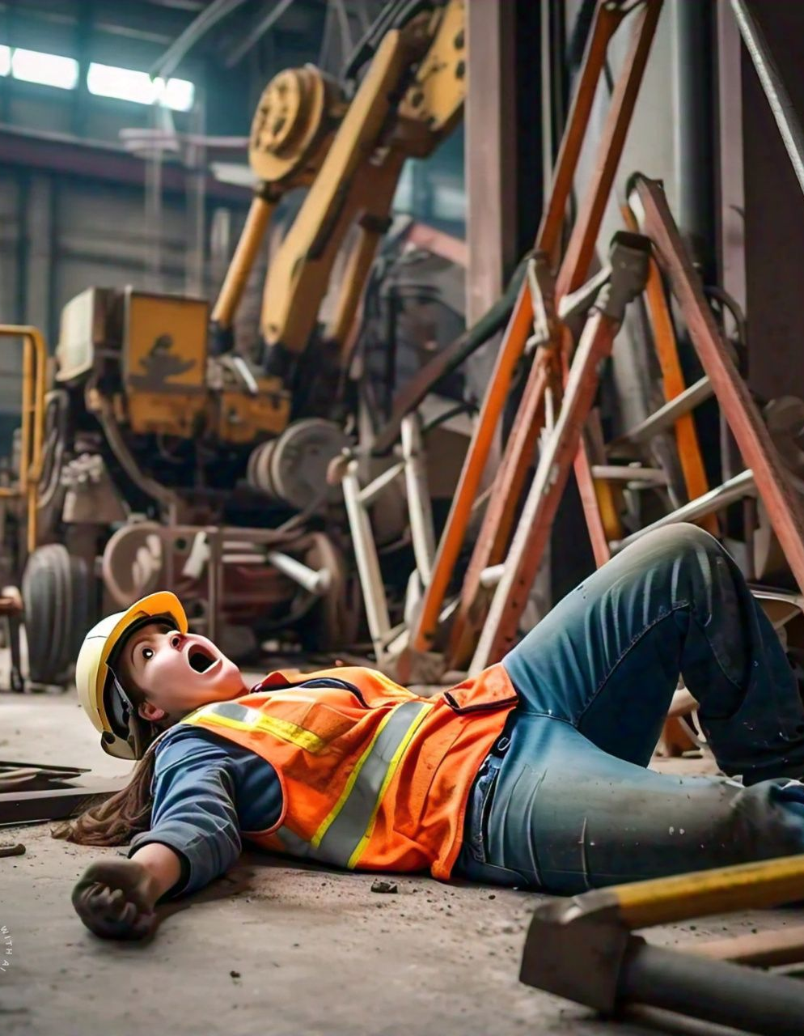
ACCIDENT
An accident is an undesirable Event that arises to injury, fatality, ill health, property damage or combination of these.
An accident is an unintentionally-caused event. An unexpected event that results in serious injury or illness of an employee and may also result in property damage.
The American Safety council has defined accident as “that occurrence in a sequence of events which usually produces unintended injury, death or the property damage.
Heinrich has defined accident as “an unplanned and uncontrolled event in which the action or reaction on an object, substance, person or radiation result in personal injury”.

Slide 26

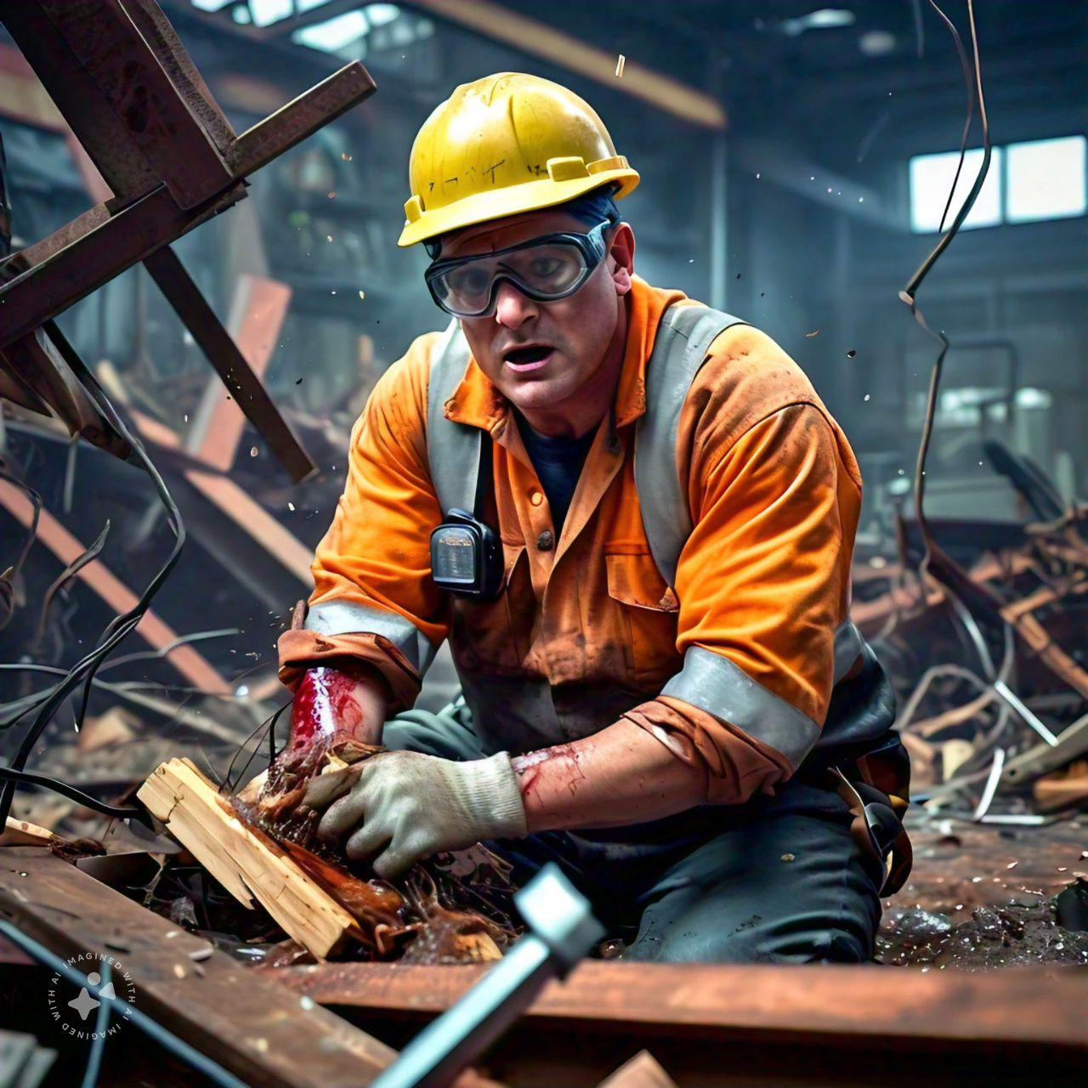
INDUSTRIAL ACCIDENTS
It can be defined as “An accident or occupational accident is an event of accident that suddenly occurs when one or no. of employees / workers placed in plant.
For instance, In an organization a person / labor while working receiving an electric current, a labor cut his finger from machine, blast in chemical industry because of various reasons, fire in textile section etc..
These are all the example of industrial accidents.

Slide 27
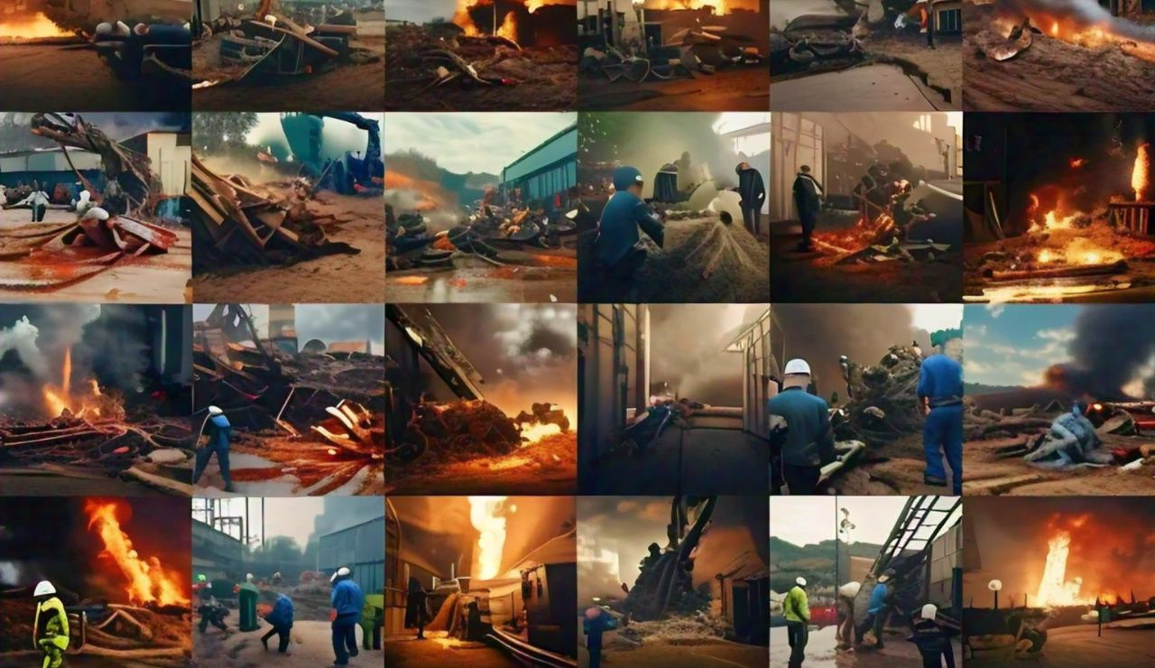

Slide 28
ACCIDENT
Accidents which take place in the work place are referred to as work place accidents or occupational accidents.
Work place accidents include events that damage property, inhibit a particular workplace function, or cause harm to a person located in the workplace.
Occupational accidents ,CALLED as work-related accidents, and the personal harm they cause may be referred to as an “occupational injury,” “occupational death
Work-related accidents may impose significant costs to the economy. These costs include direct costs due to property damage and lost worker hours, as well as indirect costs, such as due to a decrease in productivity from an accident-related decline in worker morale.
Businesses may also be forced to pay compensation costs, fines, and increased insurance premiums
Accidents that do not cause harm to any person but which have the potential to do so are referred to as a “near miss."
A situation which could lead to injurious or fatal accidents is referred to as an “undesired circumstance,” “unsafe condition,” or “unsafe act.”

Slide 29
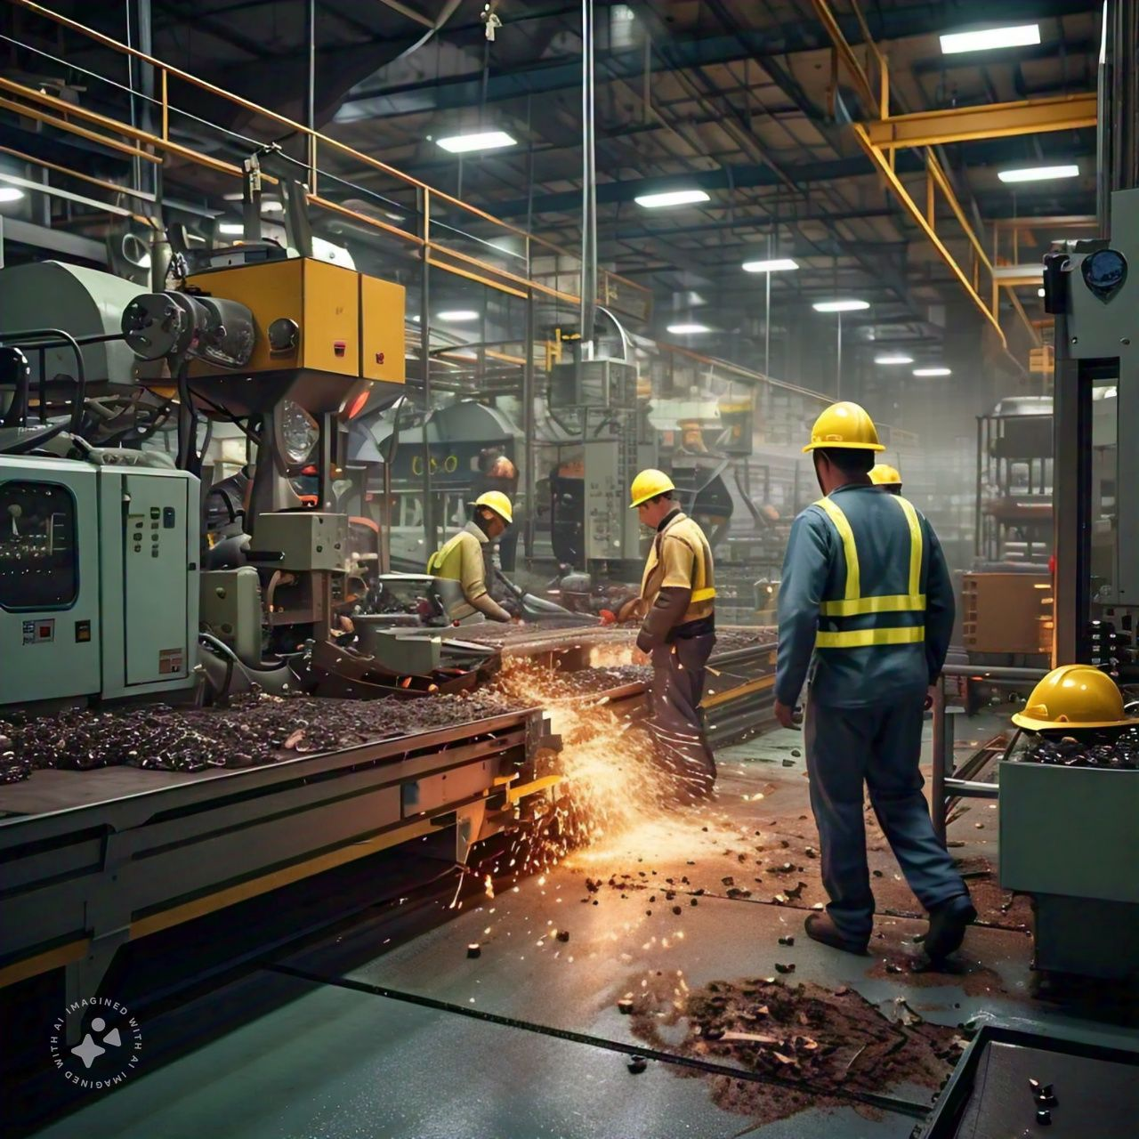
CAUSES OF ACCIDENTS
Accidents can be caused by human (behavioral) factors, such as:
o Unsafe conduct
o Inattention
o Negligence
o Improper training
o Inexperience
o Drowsiness, fatigue, or illness
• As well as by environmental and workplace design factors, such as:
o Unsafe working conditions
o Unsafe workplace design
o Substandard safety controls
o Inclement weather

Slide 30
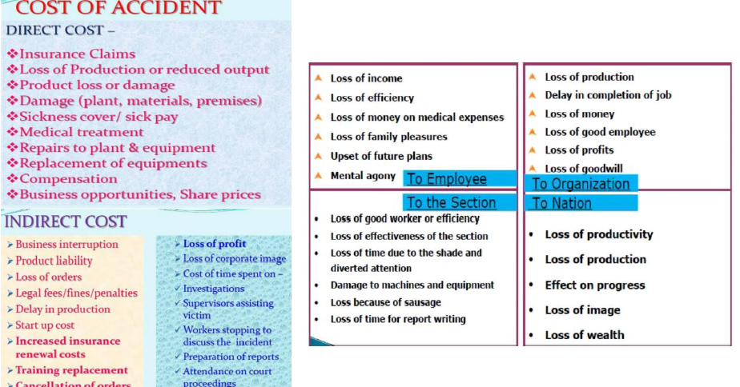

Slide 31

INJURY
An injury is any physiological damage to the human body caused by immediate physical stress.
An industrial injury is defined as “a personal injury to an employee which has been caused by an accident or an occupational disease and which arises out of or in the course of employment and which could entitle such employee to compensation under Workers’
An injury can occur intentionally or unintentionally and may be caused by blunt trauma, penetrating trauma, burning, toxic exposure, asphyxiation, or overexertion.
Injuries can occur in any part of the body, and different symptoms are associated with different injuries.
Treatment of an injury is typically carried out by a health professional and varies greatly depending on the nature of the injury.

Slide 32

An injury or illness is an abnormal condition or disorder.
Injuries include cases such as, but not limited to, a cut, fracture, sprain, or amputation.
Illnesses include both acute and chronic illnesses, a skin disease, respiratory disorder, or poisoning.
An injury is damage to your body. It is a general term that refers to harm caused by accidents, falls, hits, weapons, and more.

Slide 33
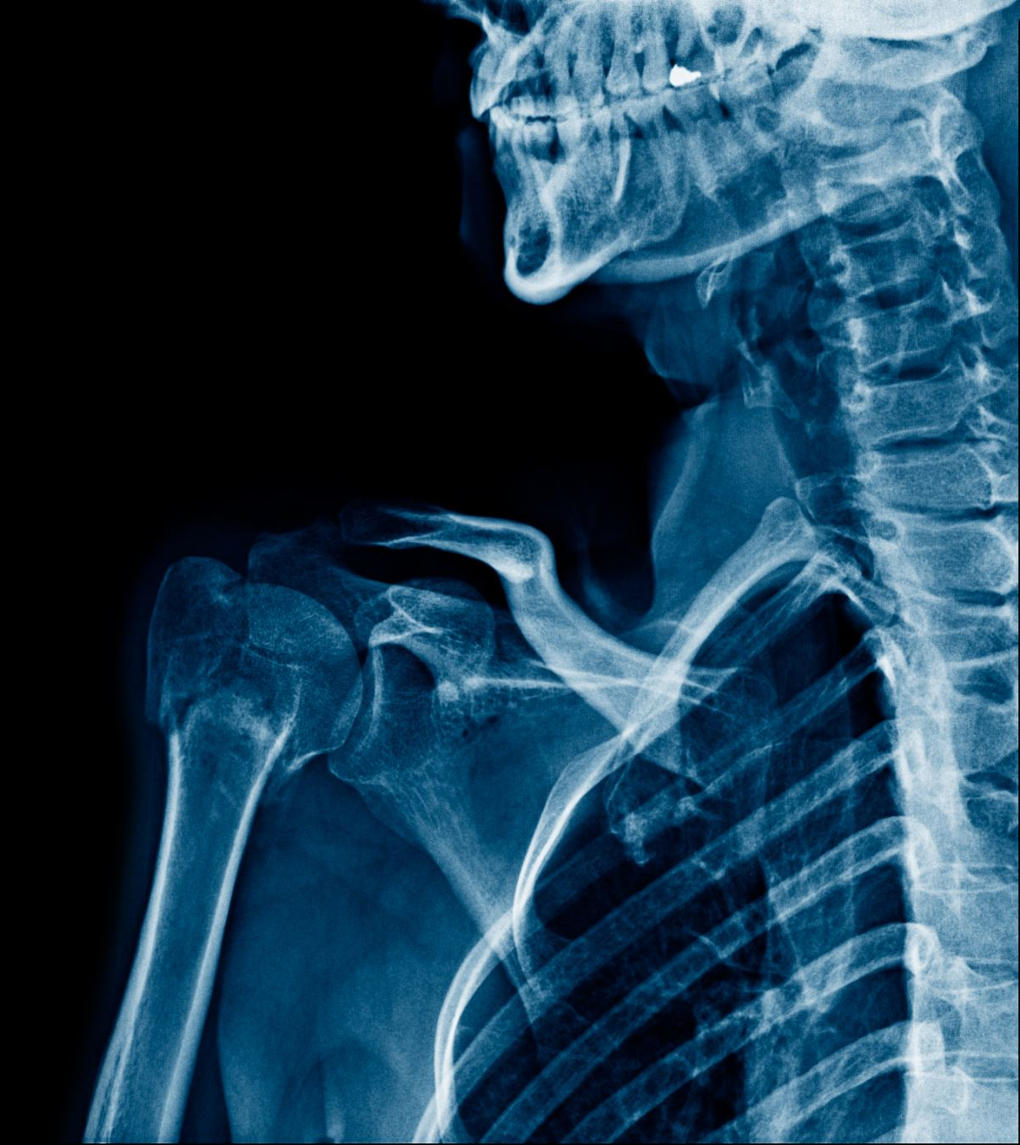
An injury can occur intentionally or unintentionally and may be caused by blunt trauma, penetrating trauma, burning, toxic exposure, asphyxiation, or overexertion.
Several major health organizations have established systems for the classification and description of injuries.
Injuries can occur in any part of the body, and different symptoms are associated with different injuries.
Treatment of an injury is typically carried out by a health professional and varies greatly depending on the nature of the injury
Injuries are distinct from chronic conditions, psychological trauma, infections, or medical procedures, though injury can be a contributing factor to any of these.

Slide 34

WHY DO ACCIDENTS HAPPEN??
UNSAFE ACTS
UNSAFE CONDITIONS

Slide 35
UNSAFE ACTS AND CONDITIONS
1.Unsafe acts : any activity or task that is conducted in a manner which increase the probabilities of an accident.
Eg: Influence of drugs, operating equipments or tools without authority, using damaged or defective equipments, not using personal protective equipments, operating equipments at improper speed, improper working position, Improper lifting, removing safety devices
2. Unsafe conditions : A condition in the workplace that is likely to cause property damage or injury
Eg: Poor or improper ventilation, poor lighting, unsafe atmosphere(heat, dust, fumes, chemicals & vibration), slippery or wet floors , congestion of working area, noise exposure, inadequate warning system, loose electrical wiring,unsafepilling stacking and storing

Slide 36
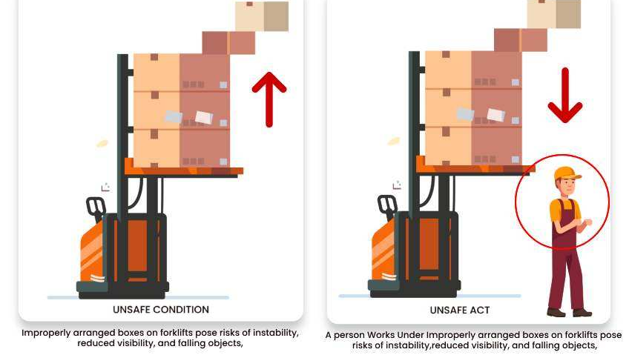

Slide 37
UNSAFE ACT
Committing mistake by person or Any act that may lead to accident is known as unsafe act.
Operating equipment without qualification or authorization.
Lack of/or improper use of PPE
Operating equipment at unsafe speeds
Failure to warn
Bypass or removal of safety devices
Using defective equipment
Working without wearing safety helmet & safety Shoes
Working at height without wearing full body harness.
Taking Rest in working Areas
working or Taking rest below Hanging Load
Over speeding
30/07/2025
37

Slide 38
HOW TO PREVENT UNSAFE ACTS
Think about how to do the task safely prior to engaging in the work.
Warn co-workers of hazards.
If you are not trained to use a piece of equipment, don’t use it.
Don’t rush your work or take shortcuts.
Use all equipment, tools, and material in the appropriate and intended manner. Don’t use a chair as a ladder.
Use proper lifting technique, a lifting device, or get assistance.
Use appropriate personal protective equipment.
Stop and mentor employees engaged in unsafe acts.

Slide 39
UNSAFE CONDITION
Any sources or situation or condition that have potential to create accident is known as unsafe condition.
Damage welding Cable
Mechanical guard not Provided on rotating parts
Defective sling or lifting equipment.
Defective work platform
Floor or platform Opening, Pits
Poor housekeeping
Defective tools, equipment or supplies
Inadequate supports or guards
Congestion in the workplace
Inadequate warning systems
Hazardous atmospheric conditions etc.
30/07/2025
39

Slide 40
HOW TO PREVENT UNSAFE CONDITIONS
Think about how to do the task safely prior to engaging in the work.
Ensure that you have all appropriate equipment, tools and material to safely do the job.
Inspect all equipment, tools and material before use. Make certain the item is in good working condition and is appropriate for the task.
Make certain that you have enough space to complete the job. Many injuries are caused because employees didn’t have sufficient room to do a job.
Injuries occur everyday because employees choose not to say anything about known hazards.
Employees identifying unsafe conditions should cease their activity and report the condition to their immediate supervisor for corrective action.

Slide 41
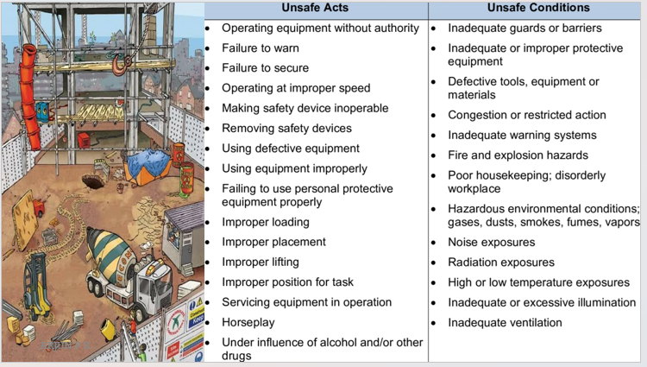

Slide 42
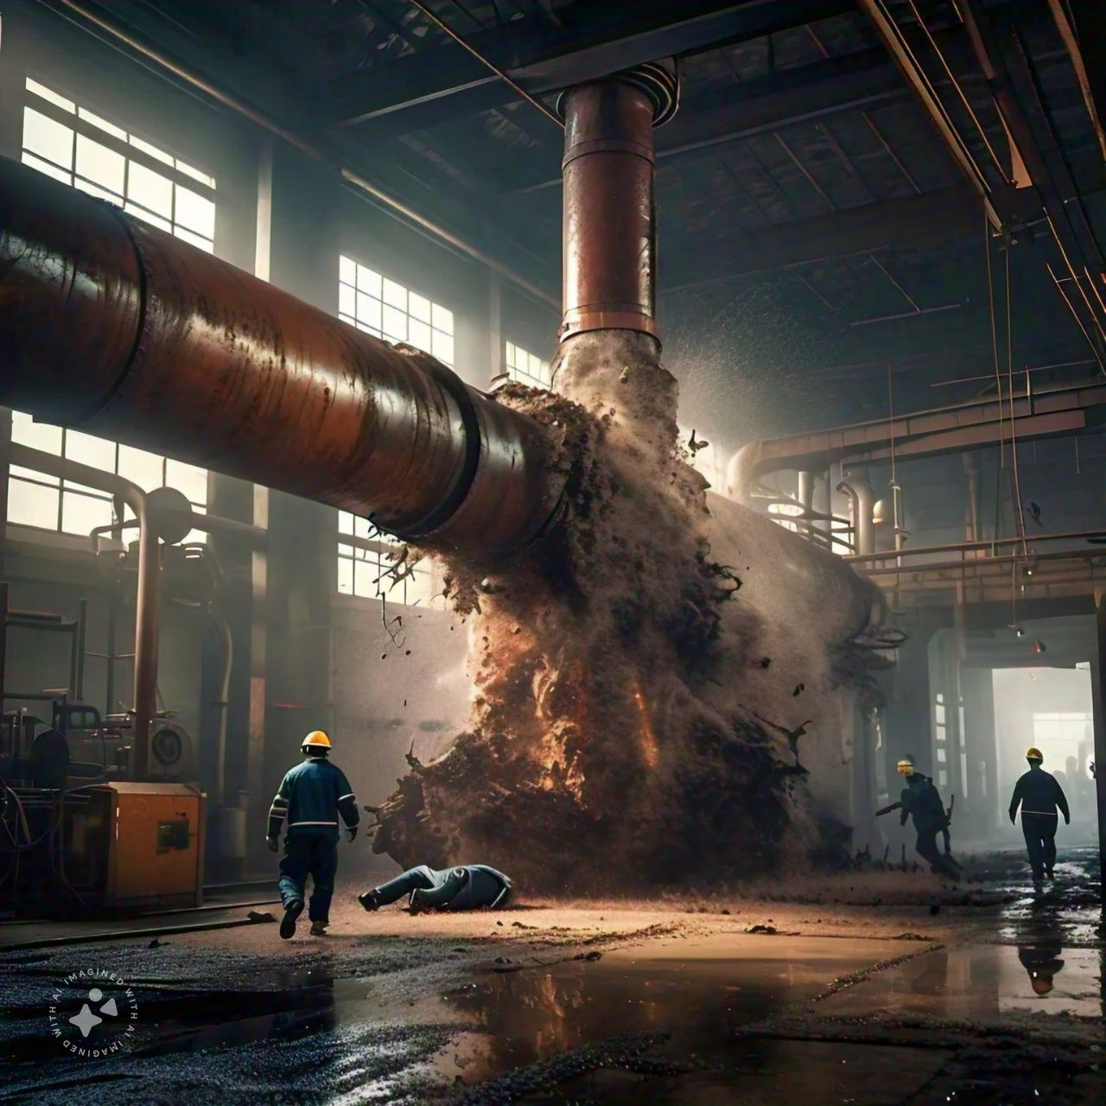
DANGEROUS OCCURANCE
These are incidents with a high potential to cause death or serious injury, but which happen relatively infrequently.
Dangerous occurrence means any occurrence that does not result in, but could (if the situation was different) cause the death of a worker or will require a worker to be admitted to a hospital as an in-patient for a period of 72 hours or more.

Slide 43
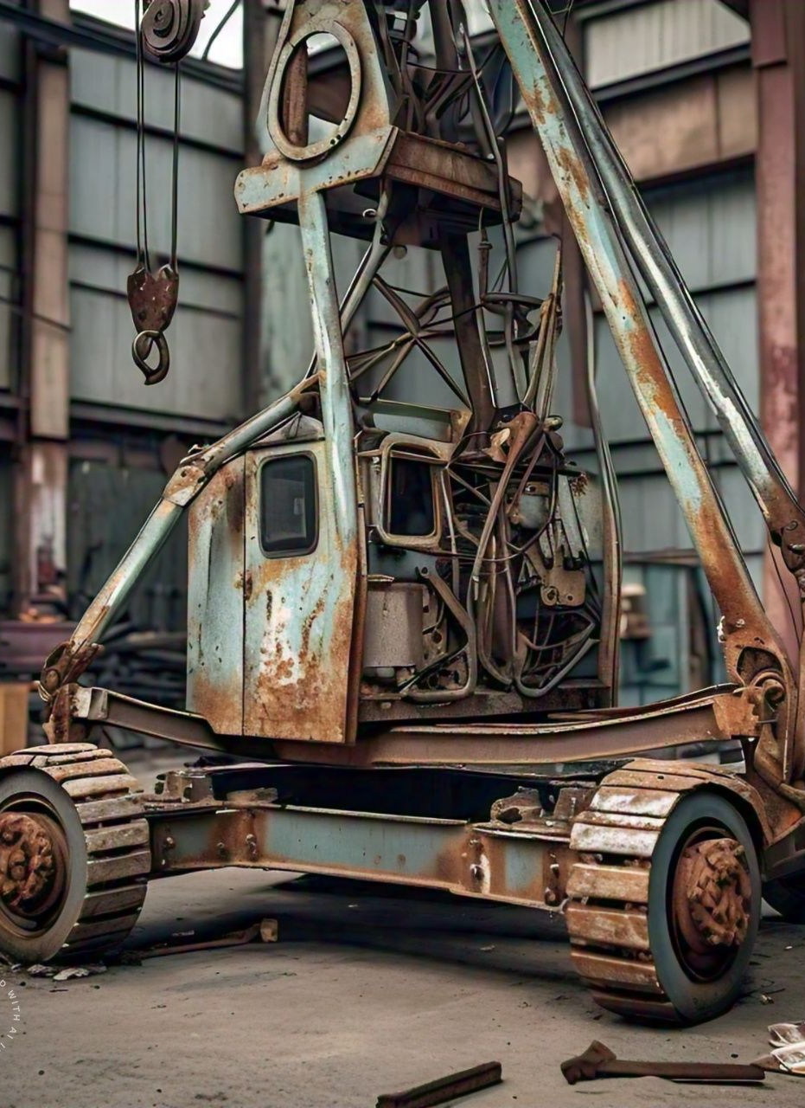
The structural failure or collapse of a structure, scaffold, temporary falsework or any part of a tunnel, trench or excavation;
The failure of a crane or hoist or the overturning of a crane or unit of powered mobile equipment
An accidental contact with an energized electrical conductor
The bursting of a grinding wheel
An uncontrolled spill or escape of a toxic, corrosive or explosive substance;
A premature detonation or accidental detonation of explosives;
The failure of an elevated or suspended platform

Slide 44
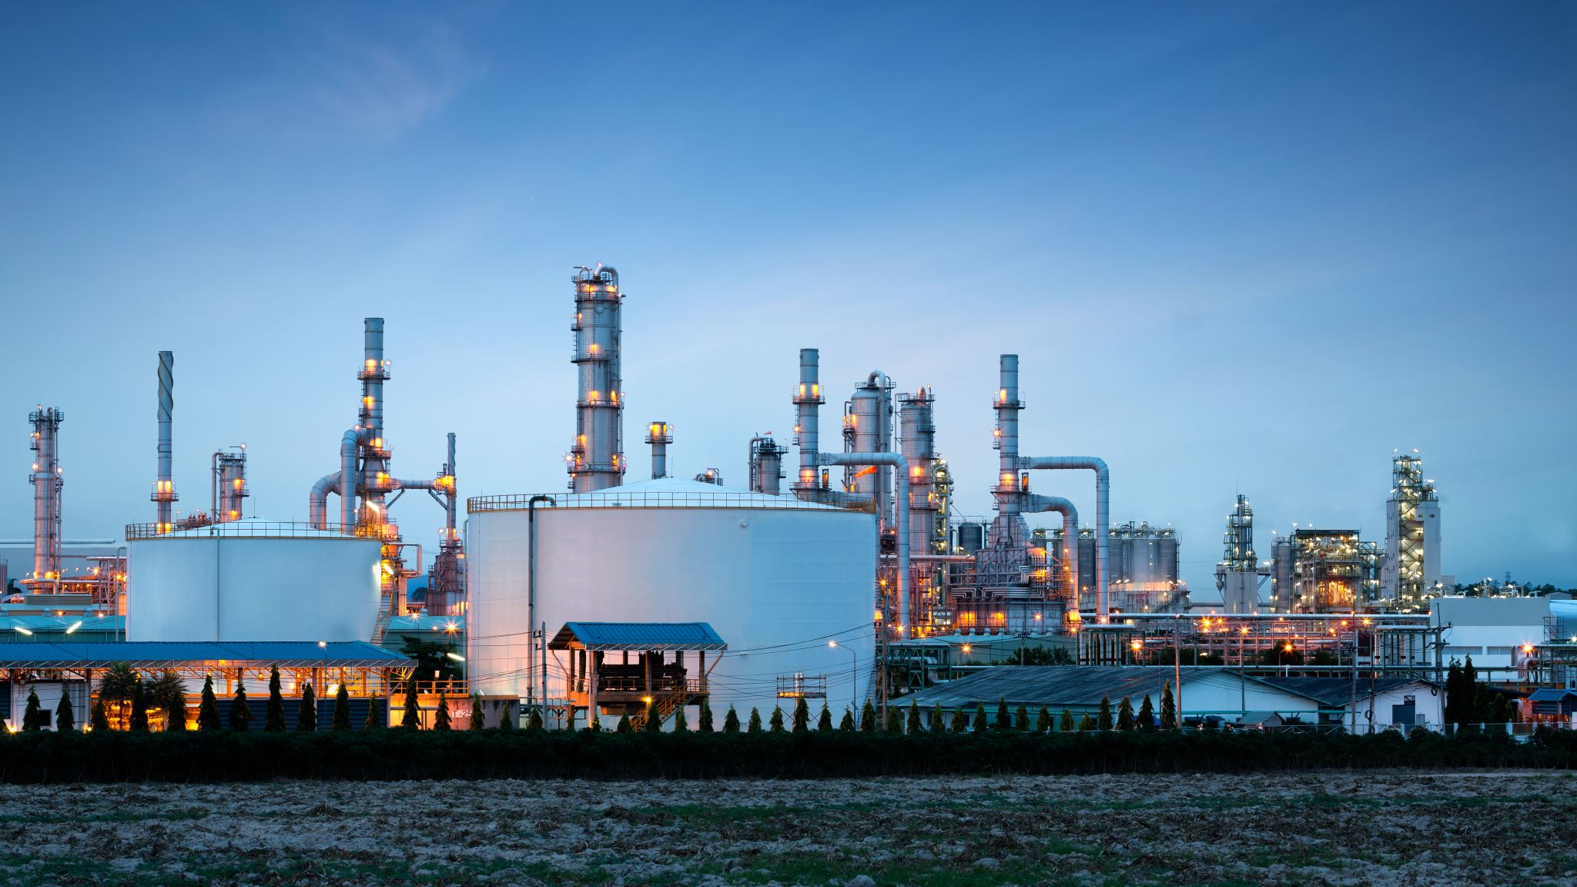
DANGEROUS OCCURANCE INCLUDES:
Lifting equipment
Pressure systems
Overhead electric lines
Electrical incidents causing explosion or fire
Explosions, biological agents
Radiation generators and radiography
Breathing apparatus
Diving operations
Collapse of scaffolding
Train collisions
Wells
Pipelines or pipeline works

Slide 45
CATEGORIES OF ACCIDENTS OF ACCIDENTS
Minor Accidents : less harmful in nature to the workers, and are easily controllable.
Preventing employees from working for the period less than 48 hours from the time of accidents and are not reported to higher management.
Reportable Accidents : little complicated than the minor accidents
here the injuries caused to worker prevent him from working for the period of 48 hours or more
supervisor is responsible to report to the higher management and arrange another worker so that the production could not be affected.
Fatal Accidents : An accident causing death or permanent or prolonged disability to the injured employee
Accidents due to dangerous occurences: It includes bursting of vessel for containing steam under pressure greater than atmospheric pressure, failure of crank or other appliances, explosion of fire causing damage to any room/place where person are employed, explosion of container used for storage of any gas or liquid at a pressure greater than atmospheric pressure.

Slide 46
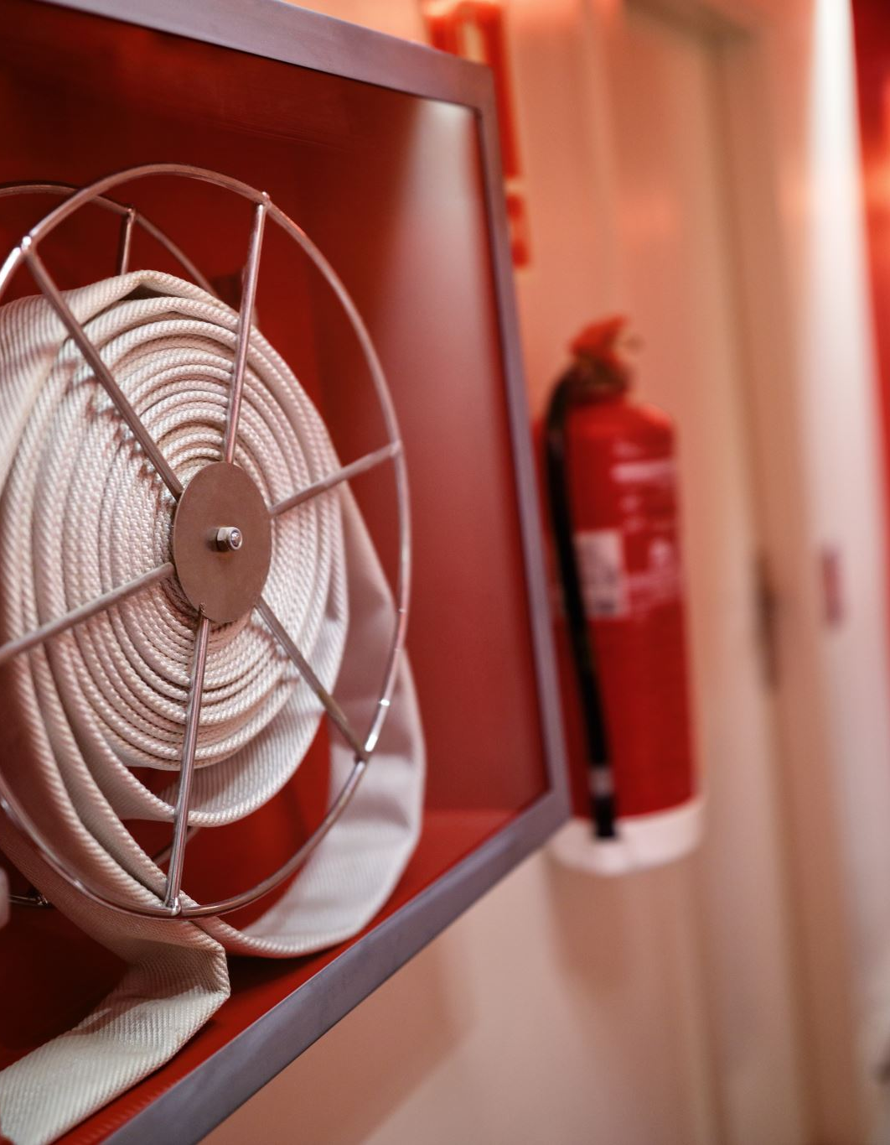
Accidents due to dangerous occurences: It is any occurrence at a place of employment that did not result in, but could have resulted in the death of a worker or required a worker to be admitted to a hospital as inpatient for 72 hours or more.
→It includes bursting of vessel for containing steam under pressure greater than atmospheric pressure
→failure of crank or other appliances
→explosion of fire causing damage to any room/place where person are employed,
→explosion of container used for storage of any gas or liquid at a pressure greater than atmospheric pressure.
→Bursting of grinding wheel
→The structural failure or collapse of a structure

Slide 47

REPORTABLE ACCIDENTS
It includes the category of accidents which is little complicated than of minor accidents.
Here the injuries caused to the worker prevent him from working for the period of 48 hours or more.
Here supervisor is responsible to report to the higher management and arrange another worker so that the production could not be affected.

Slide 48
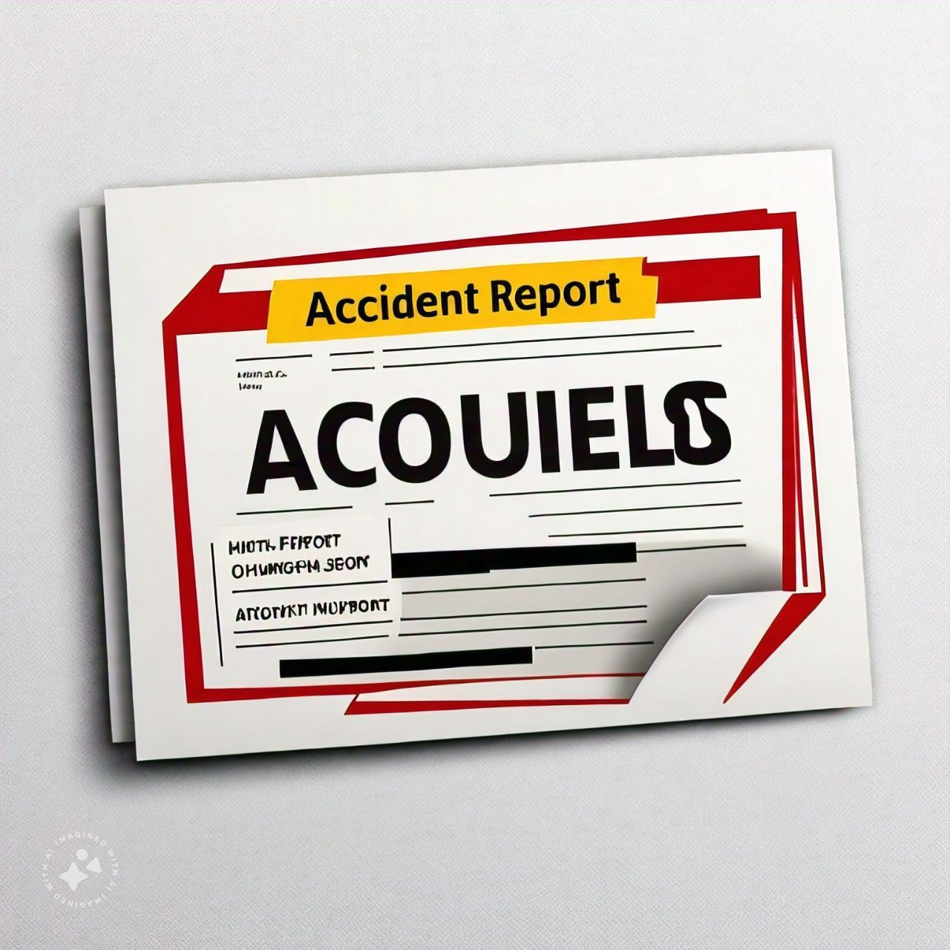

The information enables the Health and Safety Executive (HSE) and local government authorities "to identify where and how risks arise, and to investigate serious accidents".
The regulations require "responsible persons" to report deaths at work, major injuries caused by accidents at work, injuries to persons not at work that require hospital treatment, injuries arising from accidents in hospitals, and dangerous occurrences.
Under The Occupational Health and Safety Regulations, 2020, there is a legal requirement to report all serious injuries, fatalities and dangerous occurrences that occur in the workplace to Occupational Health and Safety.

Slide 49
Serious Injury or Fatality: REPORTABLE ACCIDENTS
An employer or contractor shall give notice to the Occupational Health and Safety Branch of every accident at a place of employment that: causes, or may cause the death of a worker; or will require a worker to be admitted to a hospital for 72 hours or more. The notice must include:
the name of each injured or deceased worker;
the name of the employer of each injured worker or deceased worker;
the date, time and location of the accident;
the circumstances related to the accident;
the apparent injuries; and
the name, telephone and fax number of the employer or contractor, or person designated by the employer or contractor to be contacted for additional information.

Slide 50

THEORIES OF ACCIDENT CAUSATION
There are several major theories concerning accident causation.
The domino theory
Human Factors Theory
Accident/Incident Theory
Epidemiological Theory
Systems Theory
The energy release theory
Behavior Theory

Slide 51

Accident causation theory is the art and science that seeks to understand the deeper roots of why accidents happen.

Slide 52
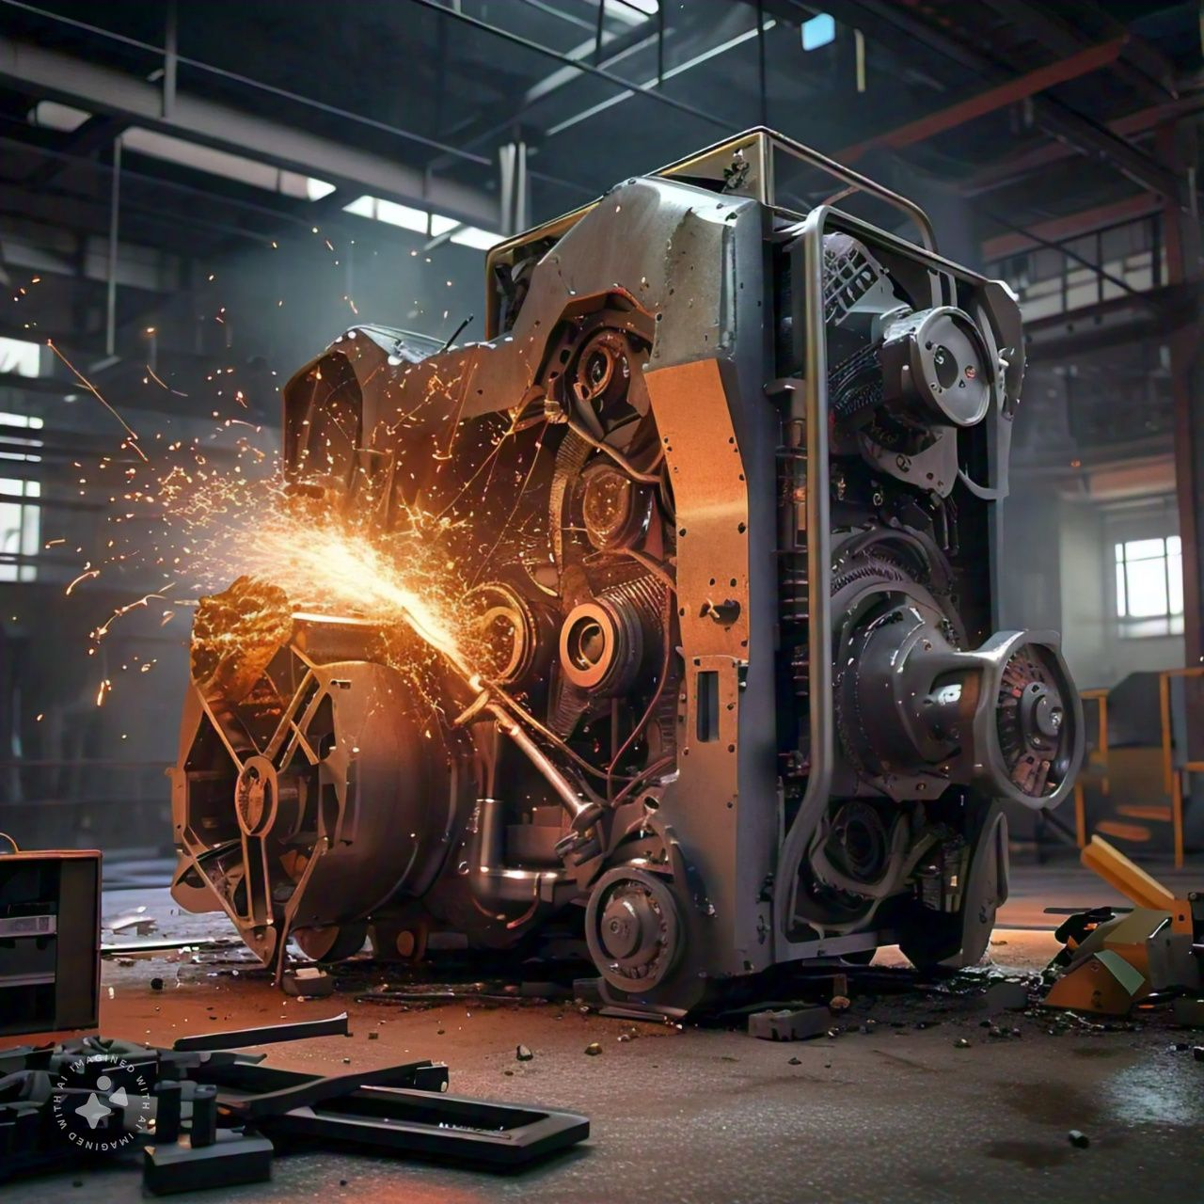
THE DOMINO THEORY
A theory of accident causation and control, developed by H.W. Heinrich.
According to Heinrich, an "accident" is one factor in a sequence that may lead to an injury
That propose that all accidents, whether in a residence or a workplace environment, are the result of a chain of events.
The chain of events consists of the following sequential factors: ancestry and social environment, an individual's mistake, an unsafe action and/or physical hazard, the actual accident, and an injury as the result of the preceding factors.
These factors are described as dominoes, and the removal of any one of these five factors can prevent the accident

Slide 53
The factors can be visualized as a series of dominoes standing on edge;
When one falls, the linkage required for a chain reaction is completed.
Each of the factors is dependent on the preceding factor.
Each of the factors is dependent on the preceding factor after studying the reports of 75 000 industrial accidents, Heinrich concluded that":
88 percent of industrial accidents are caused by unsafe acts committed by fellow workers
10 percent of industrial accidents are caused by unsafe conditions
2percent of industrial accidents are unavoidable

Slide 54
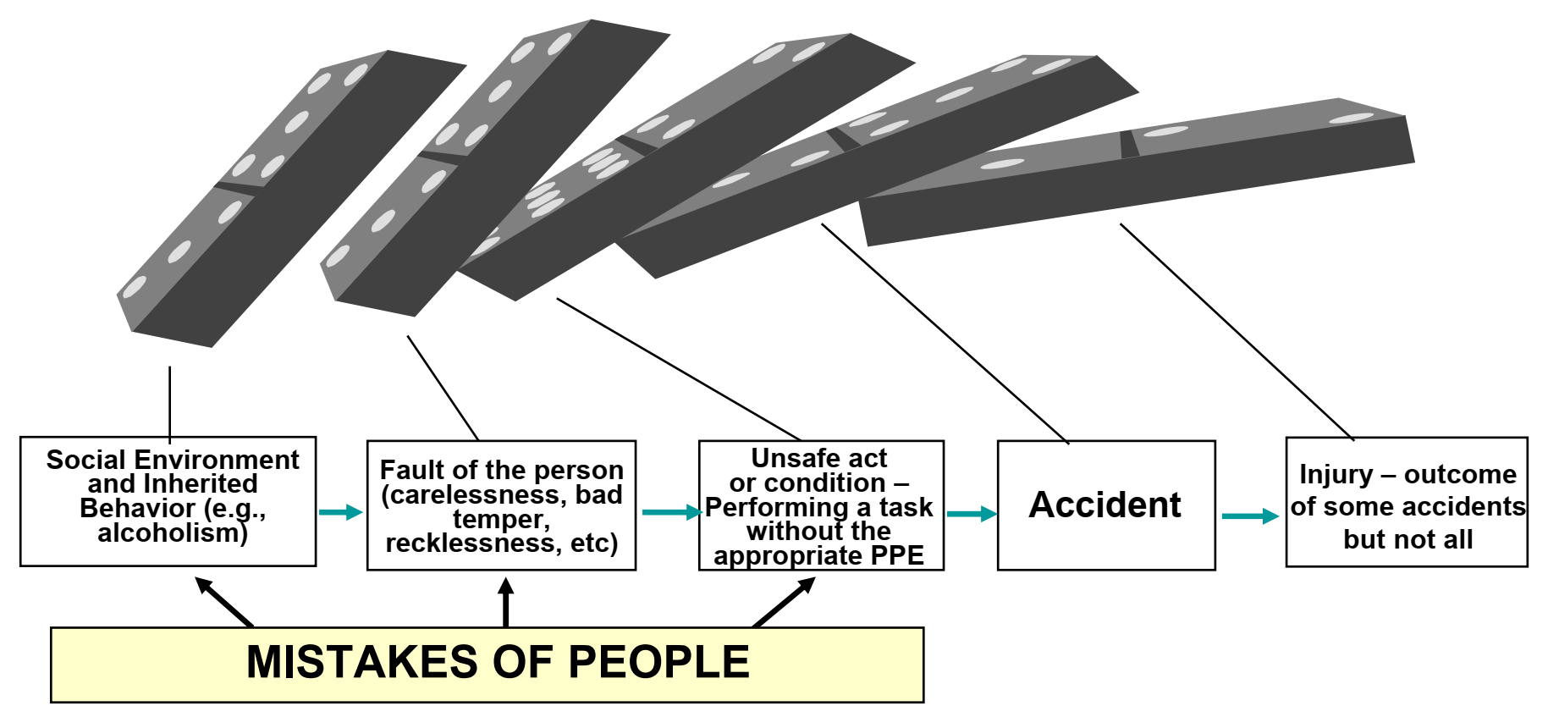

Slide 55
Heinrich’s Axioms of Industrial Safety
Heinrich’s study laid the foundation for his Axioms of Industrial Safety and his theory of accident causation, which came to be known as the domino theory
1. Injuries result from a series of preceding factors.
2. Accidents occur as the result of physical hazard or an unsafe act.
3. Most accidents are the result of unsafe behavior.
4. Unsafe acts and hazards do not always result in immediate accidents and injuries.
5. Understanding why people commit unsafe acts helps to establish guidelines for corrective actions.
6. The severity of the injury is largely fortuitous and the accident that caused it is preventable.
7. Best accident prevention techniques are analogous to best quality / productivity techniques.
8. Management should assume safety responsibilities.
9. The supervisor is the key person in the prevention of industrial accidents.
10. Cost of accidents include both direct costs and indirect costs.

Slide 56

The process…..
A personal injury (the final domino) occurs only as a result of an accident.
An accident occurs only as a result of a personal or mechanical hazard.
Personal and mechanical hazards exist only through the fault of careless persons or poorly designed or improperly maintained equipment.
Faults of persons are inherited or acquired as a result of their social environment or acquired by ancestry.
The environment is where and how a person was raised and educated.

Slide 57
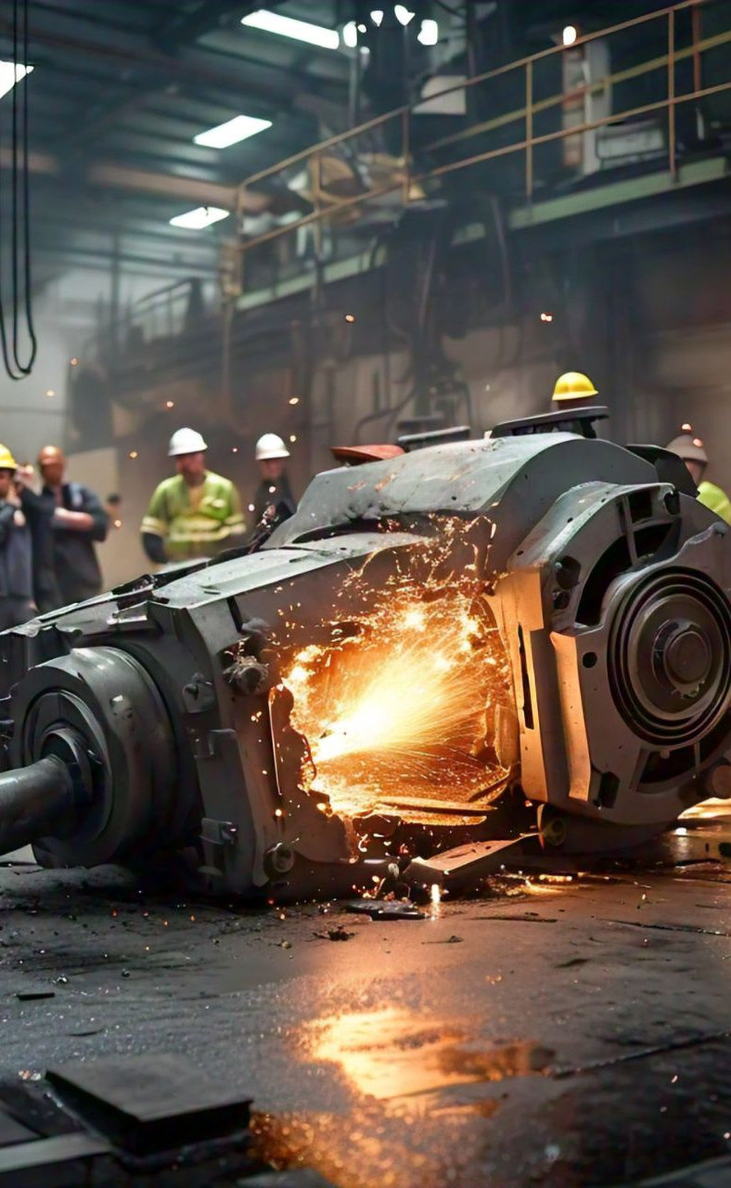
Heinrich’s Domino Theory — Critical Issues
The factor preceding the accident (the unsafe act or the mechanical or physical hazard) should receive the most attention.
Heinrich felt that the person responsible at a company for loss control should be interested in all five factors, but be concerned primarily with accidents and the proximate causes of those accidents.
Heinrich also emphasized that accidents, not injuries or property damage, should be the point of attack.
An accident is any unplanned, uncontrolled event that could result in personal injury or property damage.
For example, if a person slips and falls, an injury may or may not result, but an accident has taken place.

Slide 58
Corrective action sequence
Engineering
Control hazards through product design or process change
Education
Train workers regarding all facets of safety
Impose on management that attention to safety pays off
Enforcement
Insure that internal and external rules, regulations, and standard operating procedures are followed by workers as well as management.

Slide 59
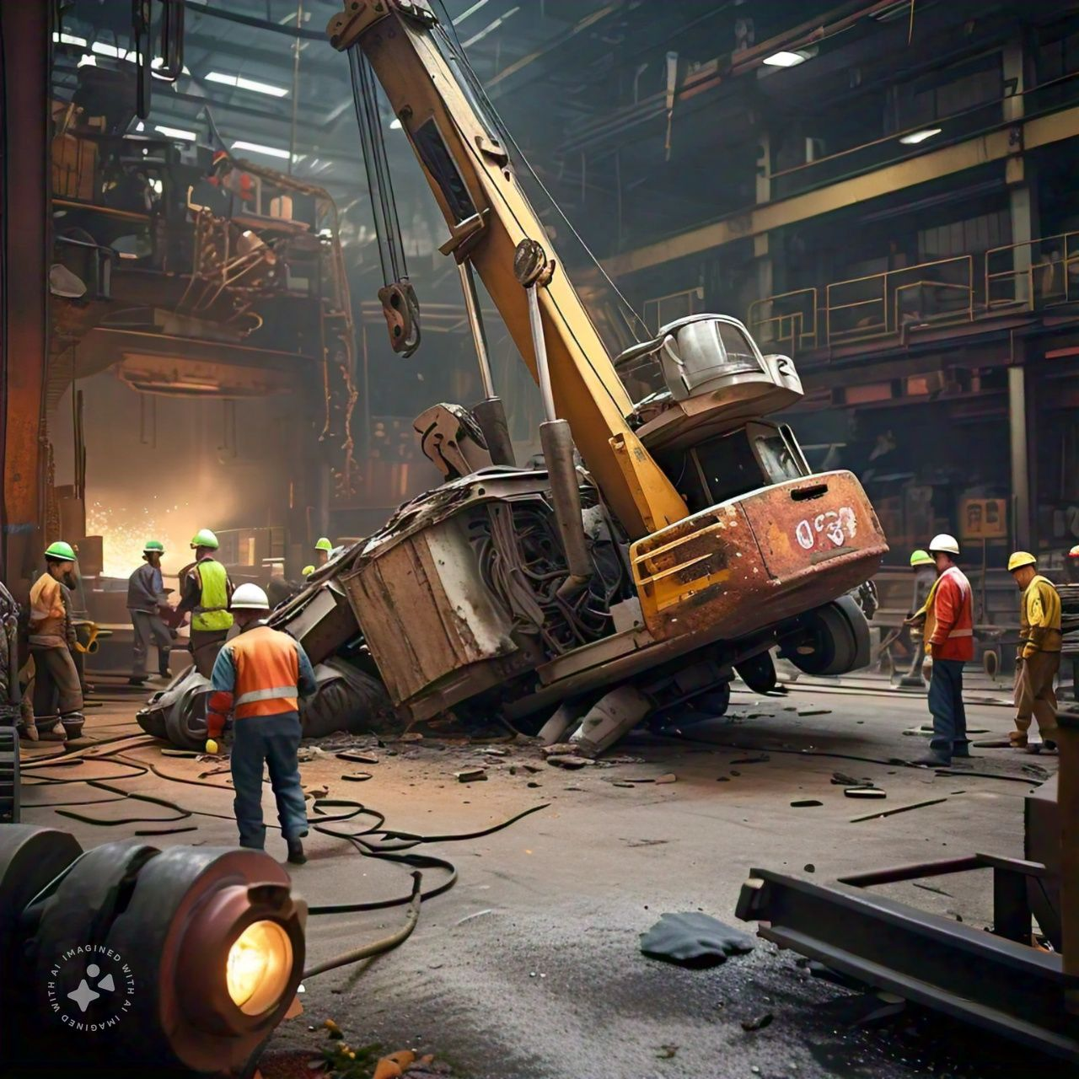
2. Human Factors Theory
The human factors theory of accident causation attributes accidents to a chain of events ultimately caused by human error.
It consists of the following three broad factors that lead to human error: overload, inappropriate response, and inappropriate activities.

Slide 60

Heinrich posed his model in terms of a single domino leading to an accident.
The assumption here is that human errors cause accidents.
These errors are categorized broadly as:
Overload
Inappropriate worker response
Inappropriate activities

Slide 61

i. Overload
Overload defines the imbalance between a person’s capacity at any given time and the load that person is carrying in a given state.
A person’s capacity is the product of such factors as his or her natural ability, training, state of mind, fatigue, stress, and physical condition.
The load that a person is carrying consists of tasks for which he or she is responsible and added burdens resulting from environmental factors (noise, distractions, and so on), internal factors (personal problems, emotional stress, and worry), and situational factors (level of risk, unclear instructions, and so on).

Slide 62
ii. Inappropriate Response and Incompatibility
How a person responds in a given situation can cause or prevent an accident.
If a person detects a hazardous condition but does nothing to correct it, he or she has responded inappropriately.
If a person removes a safeguard from a machine in an effort to increase output, he or she has responded inappropriately.
In addition to inappropriate responses, this component includes workstation incompatibility.
The incompatibility of a person’s workstation with regard to size, force, reach, feel, and similar factors can lead to accidents and injuries.

Slide 63
iii. Inappropriate activities
Human error can be the result of inappropriate activities.
An example of an inappropriate activity is a person who undertakes a task that he or she doesn’t know how to do.
Another example is a person who misjudges the degree of risk involved in a given task and proceeds based on that misjudgment.
Such inappropriate activities can lead to accidents and injuries.

Slide 64
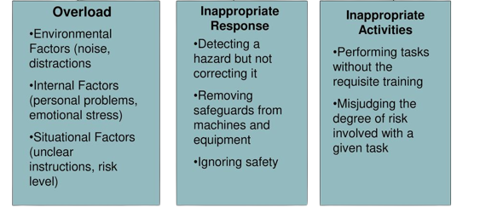

Slide 65
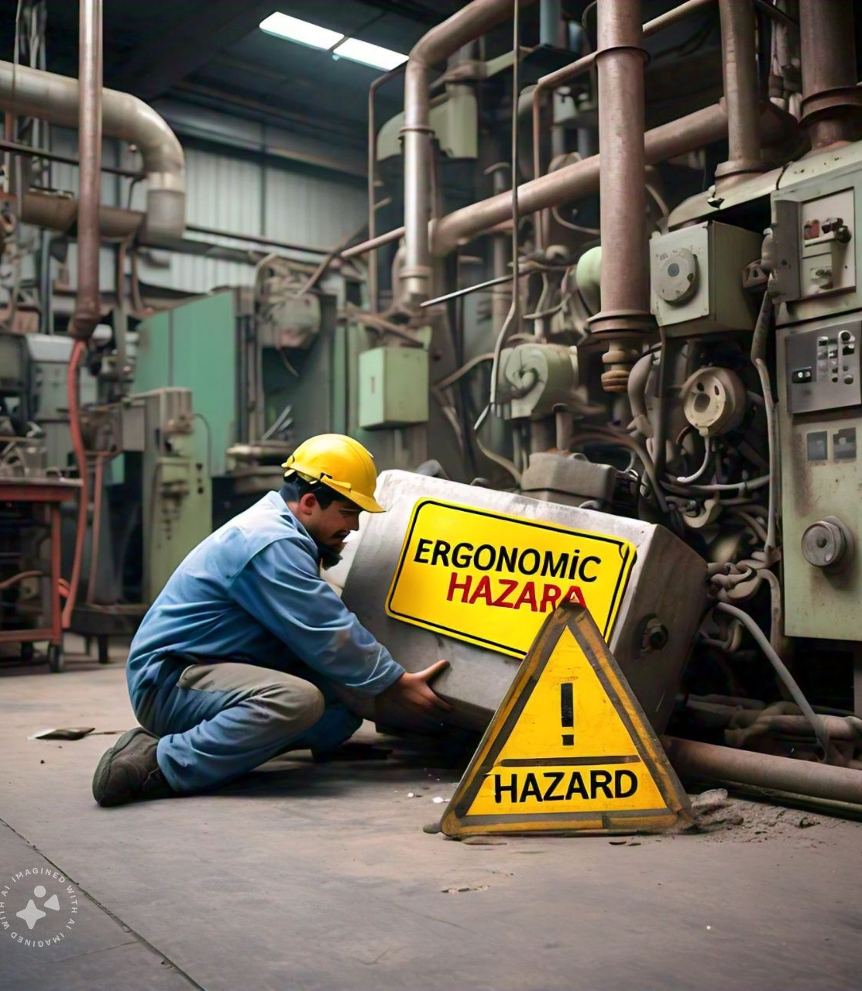
3.ACCIDENT/INCIDENT THEORY
Extension of the human factors theory.
Developed by Dan Petersen.
Introduced such new elements as ergonomic traps, the decision to err and systems failure.
In this model, overload, ergonomic traps and decision to err lead to human error.
The system failure is an important contribution of Petersen's theory.

Slide 66

Basic elements
Ergonomic traps
These are incompatible work stations, tools (management failure)
Decision to err
Unconscious or conscious human errors on making decisions, which could subsequently lead to the occurrence of accidents
Systems failure
Management failure (policy, training, etc.)

Slide 67
SOME WAYS THAT SYSTEMS FAIL -
Management does not establish a comprehensive safety policy.
Responsibility and authority with regard to safety are not clearly defined.
Safety procedures such as measurement, inspection, correction and investigation are ignored or given insufficient attention.
Employees do not receive proper orientation.
Employees are not given sufficient safety training.

Slide 68
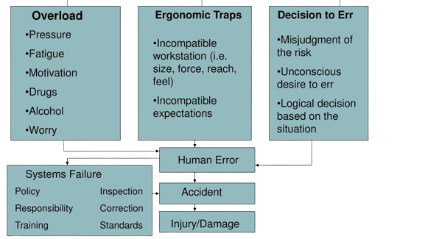

Slide 69

4. EPIDEMIOLOGICAL THEORY
Traditionally, safety theories and programs have focused on accidents and the resulting injuries.
However, the current trend is toward a broader perspective that also encompasses the issue of industrial hygiene.
Industrial hygiene concerns environmental factors that can lead to sickness, disease, or other forms of impaired health.
This trend has, in turn, led to the development of an epidemiological theory of accident causation.

Slide 70
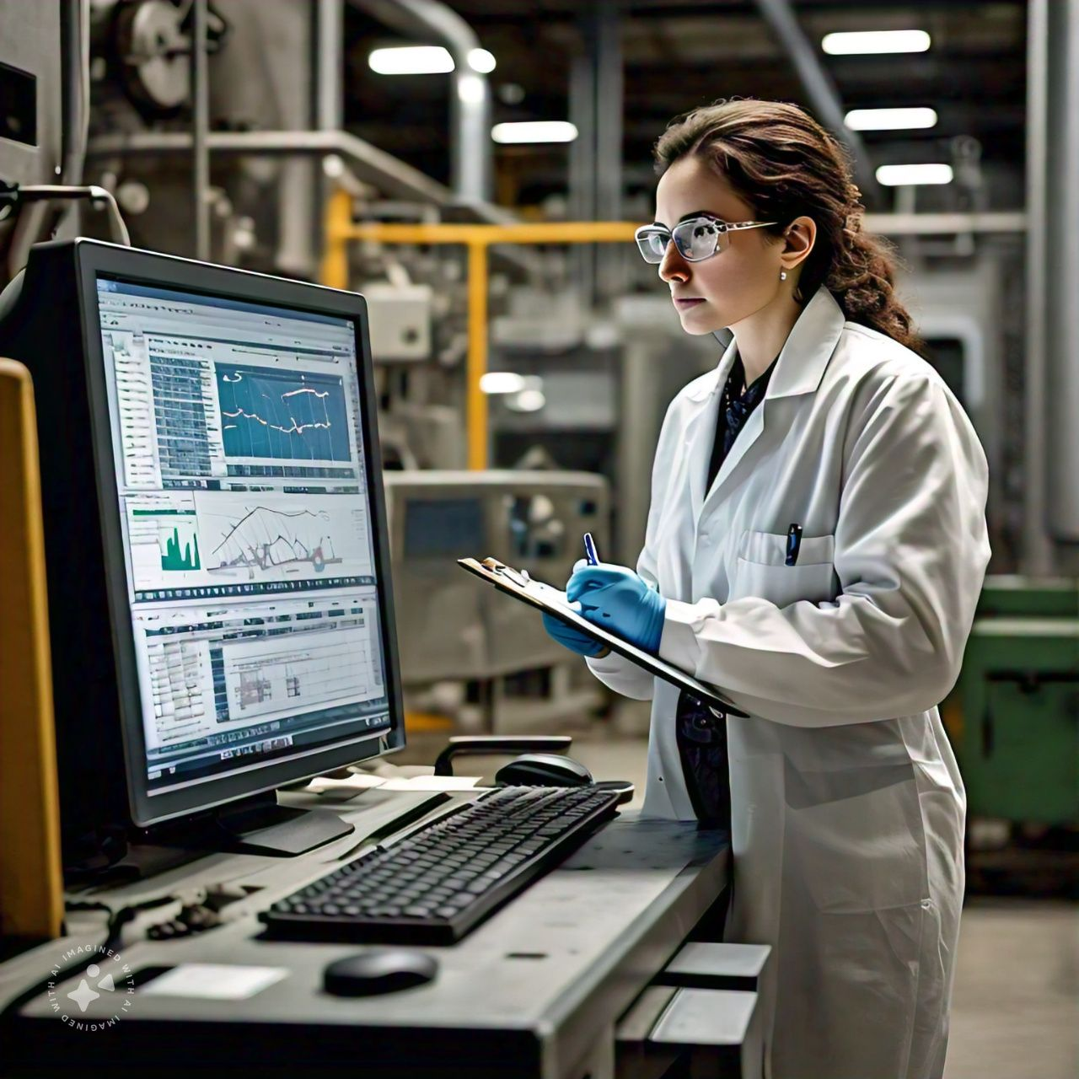
Epidemiology is the study of causal relationships between environmental factors and disease.
The epidemiological theory holds that the models used for studying and determining these relationships.
It can also be used to study causal relationships between environmental factors and accidents or diseases.

Slide 71
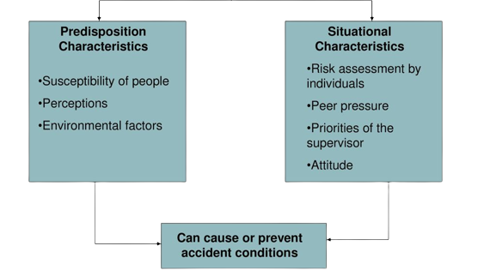
Key components

Slide 72
KEY COMPONENTS
AGENT : Hazardous conditions, actions, exposures ( eg: chemicals)
HOST : workers, more or less susceptible to injury due to individual factors (training, experience, health)
ENVIRONMENT : workplace conditions, including physical, social
VECTOR: pathways or mechanism by which agents interact with hosts (equipment, processes, procedures)

Slide 73
The key components are pre-dispositional characteristics and situational characteristics.
These characteristics, taken together, can either result in or prevent conditions that may result in an accident.
For example, if an employee who is particularly susceptible to peer pressure (pre-dispositional characteristic) is pressured by his coworkers (situational characteristic) to speed up his operation, the result will be an increased probability of an accident.

Slide 74
ACCIDENT THEORY EMPHASIS:
PREVENTION: MEASURES TO PREVENT ACCIDENTS
RISK ASSESSMENT : Systematic evaluation of hazards and risks
CONTROL MEASURES: Engineering, administrative, PPE
SURVEILLANCE: Monitoring the ongoing safety performance

Slide 75
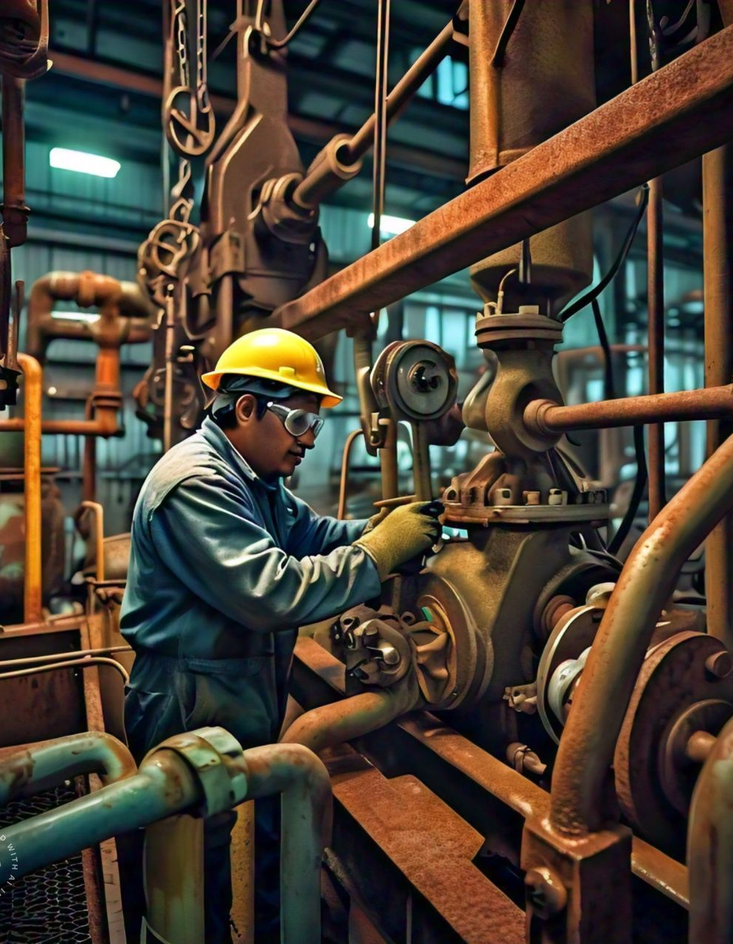
5. SYSTEMS THEORY
A system is a group of regularly interacting and interrelated components that together form a unified whole.
This definition is the basis for the systems theory of accident causation.
This theory views a situation in which an accident may occur as a system comprised of the following components: person (host), machine (agency), and environment.
The likelihood of an accident occurring is determined by how these components interact.
Changes in the patterns of interaction can increase or reduce the probability of an accident.

Slide 76
For example, an experienced employee who operates a complex machining center in a shop environment may take a two-week vacation.
Her temporary replacement may be less experienced.
This change in one component of the system (person/host) increases the probability of an accident.

Slide 77
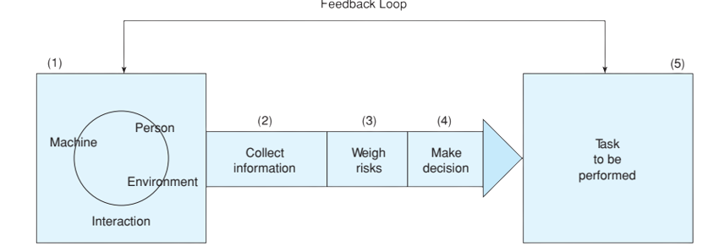
Feedback loop

Slide 78
As the model shows, even as a person interacts with a machine within an environment, three activities take place between the system and the task to be performed.
Every time a task must be performed, there is the risk that an accident may occur.
Sometimes the risks are great; at other times, they are small.
This is where information collection and decision making come in.
Based on the information that has been collected by observing and mentally noting the current circumstances, the person weighs the risks and decides whether to perform the task under existing circumstances.

Slide 79

five factors should be considered before beginning the process of collecting information, weighing risks, and making a decision:
Job requirements
The workers’ abilities and limitations
The gain if the task is successfully accomplished
The loss if the task is attempted but fails
The loss if the task is not attempted

Slide 80

6. ENERGY RELEASE THEORY/ ENERGY TRANSFER THEORY
This theory compares the rate of release of energy and relates to the kind of and severity of injuries.
The first step is to prevent the accumulation of energy by reducing the amount needed and/or providing vent release mechanisms.
The next step would be to install control methods that modify the release rate which can be accomplished with the use of space (distance) and time.

Slide 81

ACCIDENTS OCCUR WHEN ENERGY IS RELEASED OR TRANSFERRED IN AN UNCONTROLLED OR UNINTENDED MANNER , RESULTING IN HARM TO PEOPLE, EQUIPMENT, ENVIRONMENT

Slide 82
KEY COMPONENTS
ENERGY SOURCE : Potential energy stored in various forms( chemical, mechanical, thermal, electrical )
ENERGY TRANSFER: Movement of energy from one location to another.
UNCOTROLLED ENERGY RELEASE: Sudden unintended or uncontained release of energy
HAZARDOUS INTERACTION: contact between the released energy and a person, object or environment.

Slide 83
TYPES OF ENERGY RELEASE
Thermal energy : fires, explosions or burs
Mechanical energy: moving parts, falling objects, crushing forces
Electrical energy: shock, arc flash, electrical explosion
Chemical energy : toxic releases, spills, or reactions
Kinetic energy:; moving vehicles falling object, projectiles

Slide 84
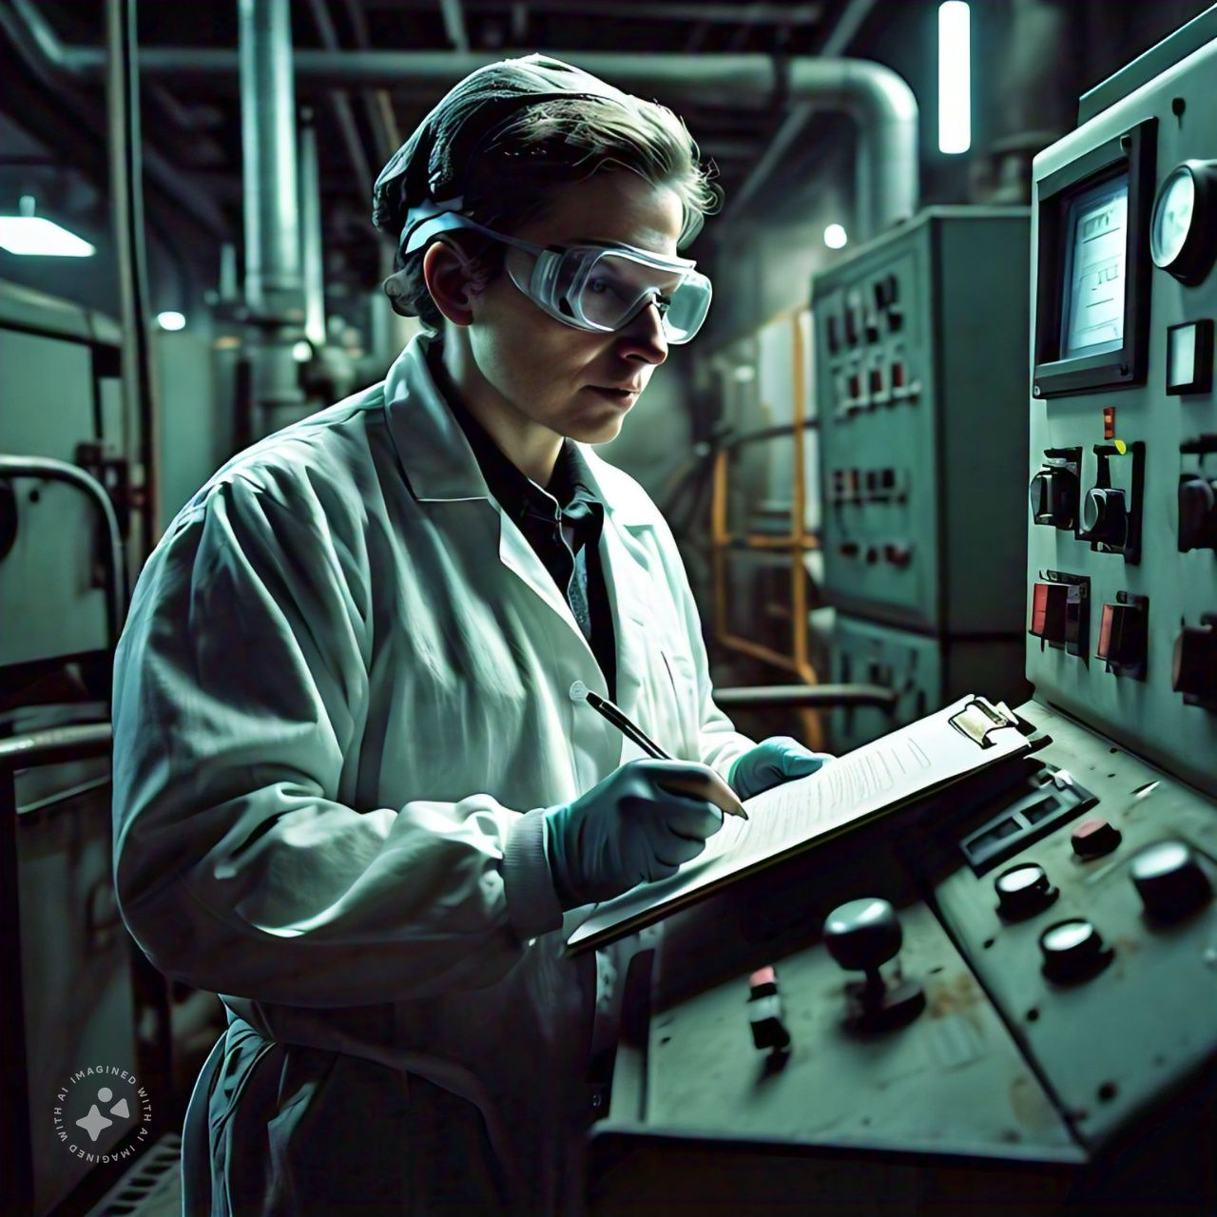
For example, a fixed barrier guard separates space by not allowing workers or machinery to reach a point of operation.
This is a separation by space.
Other control techniques include strengthen the object that may release the energy to prevent such release.
For example, slings used in hoisting operations are strength tested to withstand 2 times there working load.

Slide 85
Willam Haddon a medical doctor and the adminstrator of NHTSA at one point in time, in 1966 helped to impose the following regulations for new cars:
1. Seat belts for all occupants
2. Energy-absorbing steering column
3. Penetration-resistant windshield
4. Dual braking systems
5. Padded instrument panel
6. All measures correspond with the energy and barrier concept

Slide 86
7. BEHAVIOUR THEORY
The behavioral theory of accident causation and prevention is often referred to as behavior-based safety (BBS).
One of the most prominent proponents of BBS is E. Scott Geller, a senior partner of Safety Performance Solutions, Inc., and a professor of psychology

Slide 87

INDUSTRIAL ACCIDENTS AS A RESULT OF HUMAN BEHAVIOUR AND DECISION MAKING. IT FOCUSSES ON THE PSYCHOLOGICAL AND SOCIAL FACTORS THAT INFLUENCE WORERS ACTIONS AND DECISIONS LEADING TO UNSAFE BEHAVIOUR AND ACCIDENTS

Slide 88
KEY COMPONENTS
HUMAN BEHAVOUR: actions, decisions, and choices made by workers
MOTIVATIONS: attitude, values and beliefs
COGNITIVE PROCESS: mental process, perception, attention , memory
ENVIRONMENTAL INFLUENCE: workplace culture, situational factors

Slide 89

According to Geller, there are seven basic principles of BBS:
The behavior intersession should be visible and transparent.
Determine external factors that can help understand and improve behaviors.
Activators should be used to direct behaviors while consequences should be used to motivate behavior.
Highlight positive consequences to reinforce favorable behaviors.
Make sure that the BBS program is measurable and objective.
Don’t limit possibilities, create hypotheses and combine information gathered from the BBS program.
Create a BBS program that considers employees’ feelings and attitudes.

Slide 90
Behavior-based safety trainers and consultants teach the ABC model as a framework to understand and analyze behavior or to develop interventions for improving behavior.
As given in BBS principle, the “A” stands for activators or antecedent events that precede behavior.
“B” and “C” refers to the consequences following behavior or produced by it.
Activators direct behavior, whereas consequences motivate behavior.

Slide 91
GROUP 1
1.Discuss the adoption of accident causation theories at the workplace to prevent industrial accidents
2.What were the findings of Herbert W Heinrich's 1920 s study of the causes of industrial accidents?
3.List three characteristics of Combination Theory
GROUP 2
1.Discuss the benefits associated with understanding accident causation theories
2.What are the 3 broad factors that lead to human error in the human factor’s theory?
3.List the corrective action sequence of domino theory
GROUP 3
1.Discuss and justify the best accident causation theory to predict and prevent accidents at workplace
2.What are the systems failure component of the accident/incident theory
3.List the seven basic principles of behavior based safety
GROUP 4
1.Discuss how to evaluate the accident causation factor of the accident causation theories
2.What are the key components of the epidemiological theory? How does their interaction affect accident causation?
3.List 5 of Heinrich's Axioms of Industrial Safety
GROUP 5
1.Explain the Accident prevention in design and describe how the design of structure can affect the job site safety
2.What impact do stressors have in systems theory?
3. List 5 factors to consider before making workplace decisions that involve risk

Slide 92

SAFETY ORGANIZATION
Safety organization can be defined as the structure and process by which groups of people (employees) are divided into sections or departments, each section or department is assigned specific safety function or duty.
Authority and responsibility of everybody is clearly defined and interrelationship between them is specified for the accomplishment of organizational safety goals.
A large unit may have safety department which may have groups of people for division of such safety function and responsibilities.

Slide 93

But in a small unit (majority) if such division is not possible and only a few persons are available for safety work
They will be assigned specific duty and other departmental heads (production, purchase, personnel etc.) will be explained their role and responsibility towards safety goals.
All supervisors shall be integrated with safety as part of their duty.
‘Safety is everybody’s duty’ will be explained to all with their safety duty given in writing or by displaying at their workplaces.

Slide 94
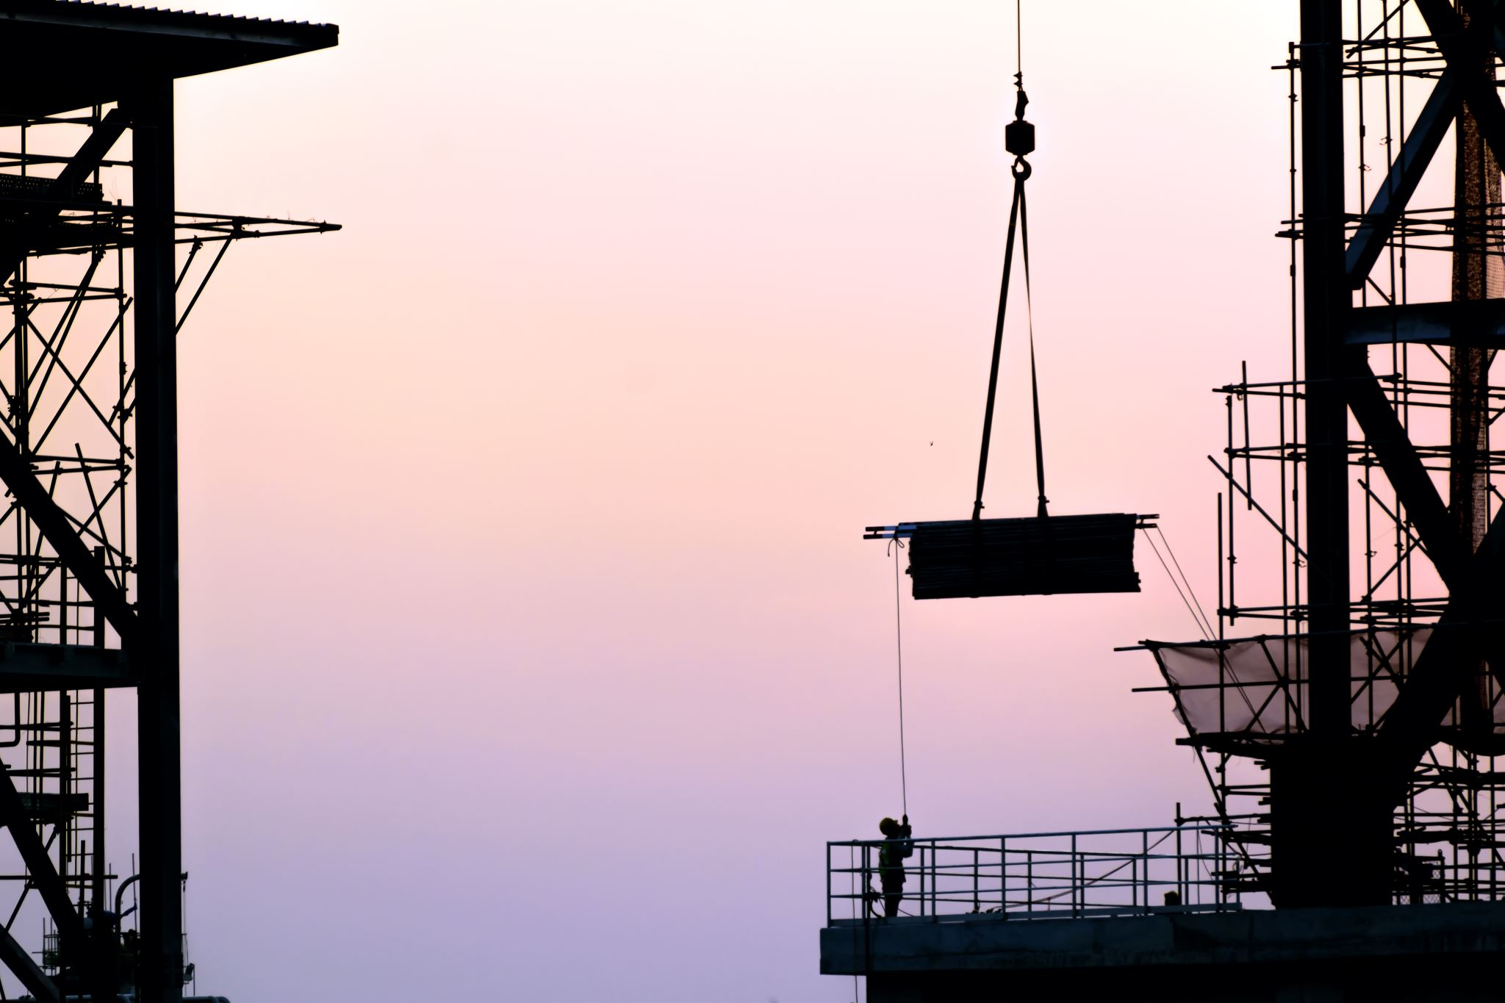
Objectives of safety organization
To prevent accidents in future
To provide safe work environment
Safety consciousness
Integrate safety policies with job process
Compliance of rules as per factory act
Ensure and modify on identified risk
Training to ensure safety
Invite cooperation and suggestions from the employees
To take measures after accident

Slide 95
Types of Safety Organization
1.Line Organization(scalar organization)
Most oldest method of administrative organization.
Line of authority is vertical flowing from top to the bottom and no staff specialists.
Features
It is the most simplest form of organization.
Line of authority flows from top to bottom.
Specialized and supportive services do not take place in these organization.
Unified control by the line officers can be maintained since they can independently take decisions in their areas
This kind of organization always helps in bringing efficiency in communication and bringing stability to a concern.

Slide 96
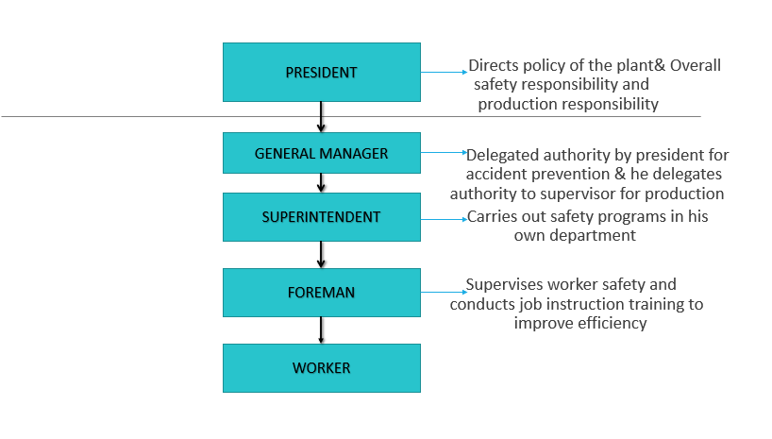

Slide 97
Merits of line organization
Demerits of line organization
1.Simplest
2.Unity of Command
3.Better discipline
4.Fixed responsibility
5.Flexibility
6.Prompt decision
1.Over reliance
2.Lack of specialization
3.Inadequate communication
4.Lack of Co-ordination
5.Authority leadership

Slide 98
Types of Safety Organization
2.Staff Organization
Line organization with specialized personnel to advise &assist all management levels.
Includes safety director, production engineer, and other specialized personnel reporting directly to general manager
It includes supervised safety committees as a part of the function

Slide 99
TOP EXECUTIVE
PRODUCTION ENGINEER
SAFETY DIRECTOR
SUPERINTENDENT
FOREMAN
WORKER

Slide 100
Merits of Staff Organization
1. Safety director has specialized experience in the organization and operation of an accident prevention program
2. Safety director may be authorized to take immediate corrective action in case of extremely hazardous operations
3. Safety director may represent management at conferences and meetings and keep updated of new methods and procedures
4. Safety director keeps top executives informed on status of safety program

Slide 101
Demerits of Staff Organization
1.Cost of added personnel.Does not fit small plants
2.Tendency of management &supervision to neglect responsibility for safety ,leaving it to the safety director

Slide 102
FUNCTIONS & DUTIES OF SAFETY ORGANIZATION
• Monitoring implementation of all directives issued in matters pertaining to safety.
• Ensuring super checks of functioning of operational & maintenance activities.
• Implementation of safety circular & safety drives
• To coordinate disaster management functions, relief, & restoration etc.
• Assisting authorities in conducting inquires in serious accidents.
• Counselling & monitoring of staff involved in maintenance & operations

Slide 103
Role of management in safety
1.Design safer systems of work
2.Exhibit commitment
3.Inspect the workplace
4.Establish procedures and controls
5.Develop training programs
6.Set up health and safety committees

Slide 104
Role of supervisors in safety
1.Ensure safety and healthy issues brought to their attention are resolved in a timely manner
2.Walking routinely through their areas of responsibility and soliciting input from employees on safety and health issues
3.Communicating to employees the status of safety items, that is results of inspections, of incident investigations, trending data, resolution of safety concerns, upcoming events etc
4.Allocating the necessary resources to ensure the appropriate integration of safety measures with work tasks
5.Participating in the development and communication of unit safety, health goals, and action plans
6.Ensuring that employees are aware of all physical & chemical hazards in workplace and how to control them for accident prevention

Slide 105
Role of supervisors in safety
7.Allowing employees to participate in inspections ,investigations, hazard assessments and safety reviews
8.Organising &personally attending monthly safety meetings
9.Beginning safety meetings with safety share
10.Ensuring that the employees understood and can explain-stop work authority, safety policy discipline policy etc
11.Holding employees accountable for their safety contributions and providing constructive feedback as needed throughout the year

Slide 106
Role of workmen in Safety
A worker should keep the following personal responsibilities in mind:
must not remove any safety equipment from machines or equipment. This includes shields from grinders, mixers, etc.
must have had adequate instruction about a piece of machinery or equipment before using it
must make sure that no machine, equipment, or tool is used in a way that would cause injury to someone else.
must make sure that there are safe entrances to and exits from the workplace.
must make sure that the work area is safe for the movement of workers, equipment, and materials.
must wear protective eyewear when using grinders and equipment that may be hazardous to the eyes.

Slide 107
Role of unions in Safety
Surveying membership on their workplace health and safety concerns.
Conducting investigations of injuries, illnesses and near-misses.
Monitoring workplace conditions
Educating members and leaders about specific health and safety issues.
Developing strategies for getting issues concerning worker health and safety addressed.
Filing and following up on occupational health and safety complaints

Slide 108
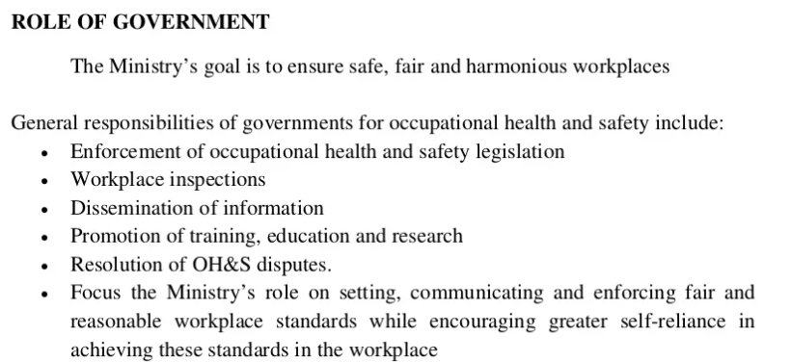
Role of Government in safety

Slide 109
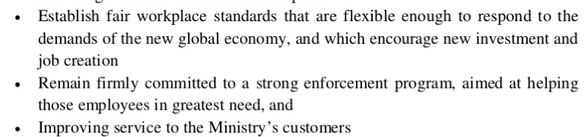
Role of Government in safety

Slide 110
SAFETY POLICY
An industry or a company that follows safety programmes is benefitted in several ways.
The benefits are shared between employer and employees directly
Consumers - indirectly benefitted.
A sound safety policy will avid or reduce greatly the accidents whereby the employer will save cost of lost man-hours and down-machine time.
The employer will also save on paying compensation and replacement or repair of equipment.
The employees feeling safe to work will show better productivity.

Slide 111
SAFETY POLICY
Sound safety policy will guarantee an adequate compensation, the employees will work without apprehension and psychological pressure,
The latter factor often causes accidents
The increased productivity and quality consciousness will produce goods which will be to the liking of the customer.

Slide 112
SAFETY POLICY
A recognized written statement of its commitment to protect the health and safety of the employees as well as the surrounding community.
Details the measures the company takes & will take to protect the life and health of their employees.
There are three sections
Statement of the policy
Responsibility
Arrangements or procedures

Slide 113
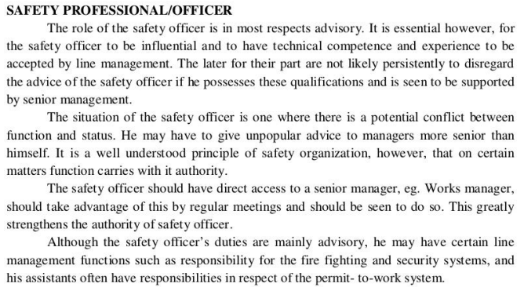

Slide 114
Safety officer
Internal employee assigned to prevent accidents,respond to emergencies &evaluate the effectiveness of the company’s safety programs
Identifies safety hazards,investigates them thoroughly and controls them before someone gets hurts
Head of safety department
Checks if the safety program is working effectively and efficiently to meet all requirements of the OSHA standards

Slide 115
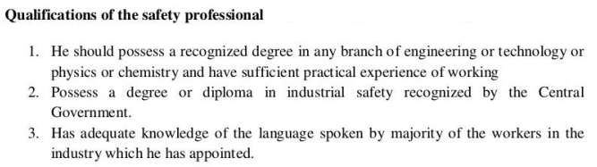

Slide 116
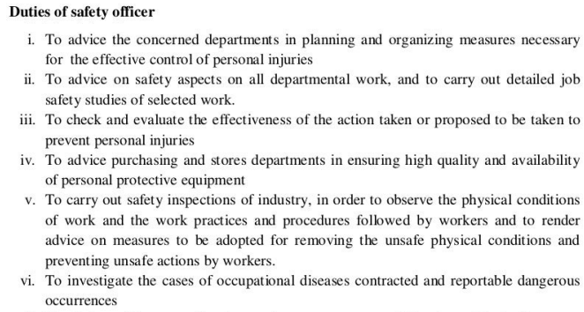

Slide 117
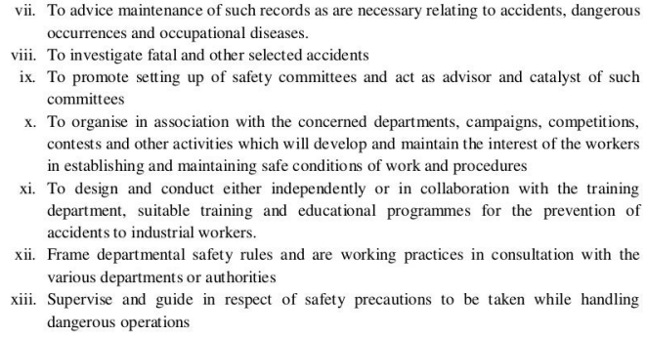

Slide 118
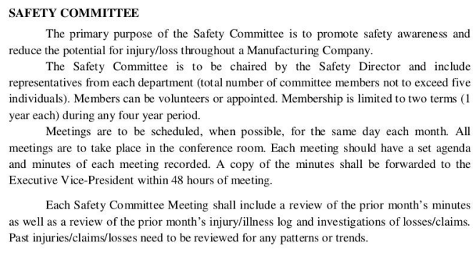

Slide 119
The Importance of Establishing a safety committee
Safety committees help provide an overall perspective of the safety status of the organization.
It serves as a visible body that can be approached for safety or health complaints, suggestions, and other types of feedback.
As the committee solely deals with safety-related issues, it ensures that there are employees focused on and dedicated to coordinating safety-related activities. It also encourages and motivates employees to follow safety standards and signals to them that the organization is taking measures to protect their wellbeing.

Slide 120
Functions and duties of a safety committee
Developing written safety programs
Promoting safe workplace practices.
Facilitating safety training.
Performing workplace inspections.
Carrying out accident investigations.
Acting as a point of contact between employees and management.
Reviewing injuries and illness records.
Identifying hazards and recommending appropriate control measures.

Slide 121
TYPES OF SAFETY COMMITTEE
Labor management committee:-Prevalent in organizations having union contracts which contain safety clauses that designate the joint acceptance of responsibility and specific activities of labour and management. Union members of this committee are appointed by union
Management committee:-When there is no union agreement or where the contract contains no safety clause,the safety committee functions directly under the policies by management

Slide 122
TYPES OF SAFETY COMMITTEE
Management supervisors committee: Committee formed entirely of supervisory personnel. Supplements the activities of the committee which include workers
Technical committee: Useful on specific problems or activities for which specialized knowledge is needed. May consist of engineers ,safety engineers, chief electrician, master mechanic etc. Handle problems requiring engineering revision, controls or guard designs etc
Special committee:-Set up for specific activities such as safety- contests,celebrations or awards ,accident investigations etc.Dismissed after the completion of activity

Slide 123
Safety features laid down by Indian Standards Institute:
Safety precautions to be taken during manufacturing process
Requirements for effective maintenance of tools and equipment's
Standards for proper layout, proper lighting, ventillations for factory building
Guidance on safe welding and cutting, use of fire fighting equipment's
Standards and specifications of safe industrial operations and practices
Classification of hazardous chemicals and use of accident prevention tags and labelling of dangerous goods
Safety codes for handling acids and other chemicals
Safety requirement for PPE
Standards for fire safety in industrial buildings, safety procedures to be followed in electrical work.
Specifications for protective clothing, safety helmets, face shields and safety equipments for eyes, ears , lungs.( gas mask, gloves, safety boots

Slide 124
GENERAL FUNCTIONS WITH OBJECTIVES AND DUTY OF SAFETY COMMITTEE
1. Management Commitment to Workplace Safety and Health
Establish procedures for review and management's response to minutes.
Submit written recommendations for safety/health improvement/changes and response.
Evaluate employer's safety/health policies and procedures.
Respond in writing to safety committee recommendations. Review corrective action taken by management.
2. Committee Meetings and Employee Involvement
Establish procedures for employee input, i.e. to receive suggestions, report hazards, and other pertinent safety and health information.
Include employee input on agenda for safety committee meetings.
Hold monthly meetings, Keep meeting minutes.
Develop and make available a written agenda for each meeting.
TAke meeting minutes and distribute to management and the safety committee members.

Slide 125
3. Hazard Assessment and Control
Establish procedures for workplace inspections to identify safety and health hazards. • Assist the employer in evaluating the accident and illness prevention program.
Appoint an inspection team of at least one employee representative and one employer representative.
Conduct workplace inspections at least quarterly.
Make a written report of hazards discovered during inspections.
Review corrective measures. Make written recommendation to correct the hazard, and submit it to management for timely response.
Identify high risk job tasks and develop written safe operating conditions.
4. Safety/Health Planning
Establish procedures to review inspection reports and make appropriate implementation of new safety/health rules and work practices.
Develop/establish procedures for an annual review of the company safety and health program.

Slide 126
5. Accountability
Evaluate the company safety and health accountability program.
Make recommendations to implement supervisor and employee account ability for safety and health.
6. Accident/Incident Investigations
Establish procedures for reviewing reports completed for all safety incidents, including injury accidents, illnesses and deaths.
Review these reports so that recommendations can be made for appropriate corrective action to prevent recurrence.

Slide 127
7. Safety/Health Training for Committee-Members
Identify and make accessible applicable OSHA standards and other codes that apply to your particular industry.
Provide specific training on your type of business activity. Include, hazard identification of the workplace and how to perform effective accident incident investigation.
Identify the location of safety procedures provided with appropriate equipment and inform employees of their location.
Recommend training for new employees and refresher training on company, department and work location safety practices, procedures and emergency response. • Management should maintain (and make available to the safety committee) records on employee safety training.

Slide 128

THANKYOU

